Slide 1
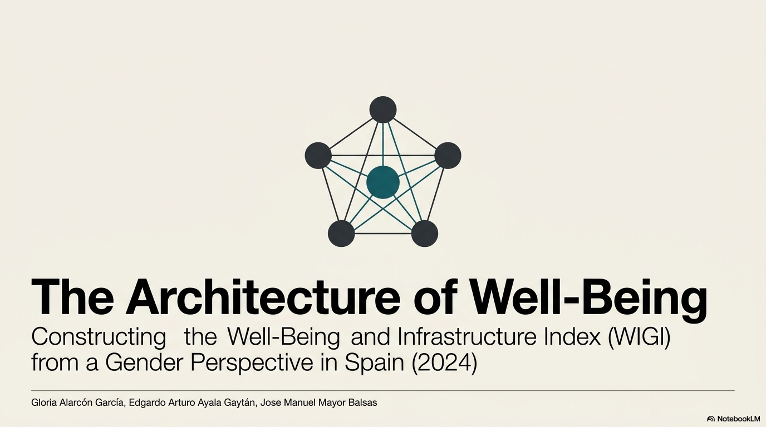

Slide 2
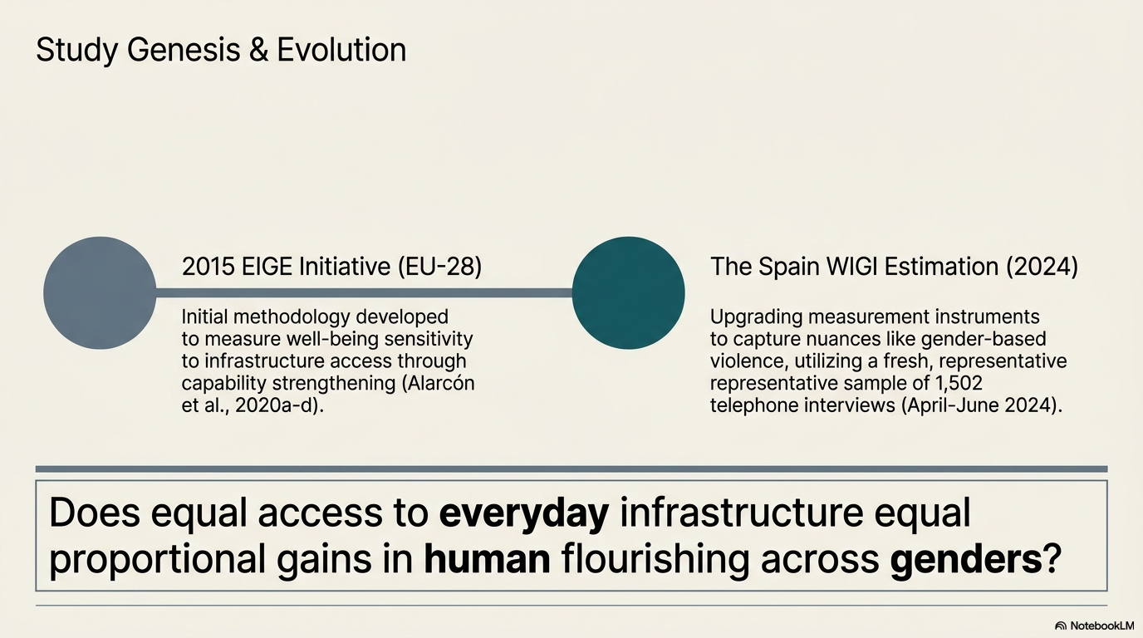

Slide 3
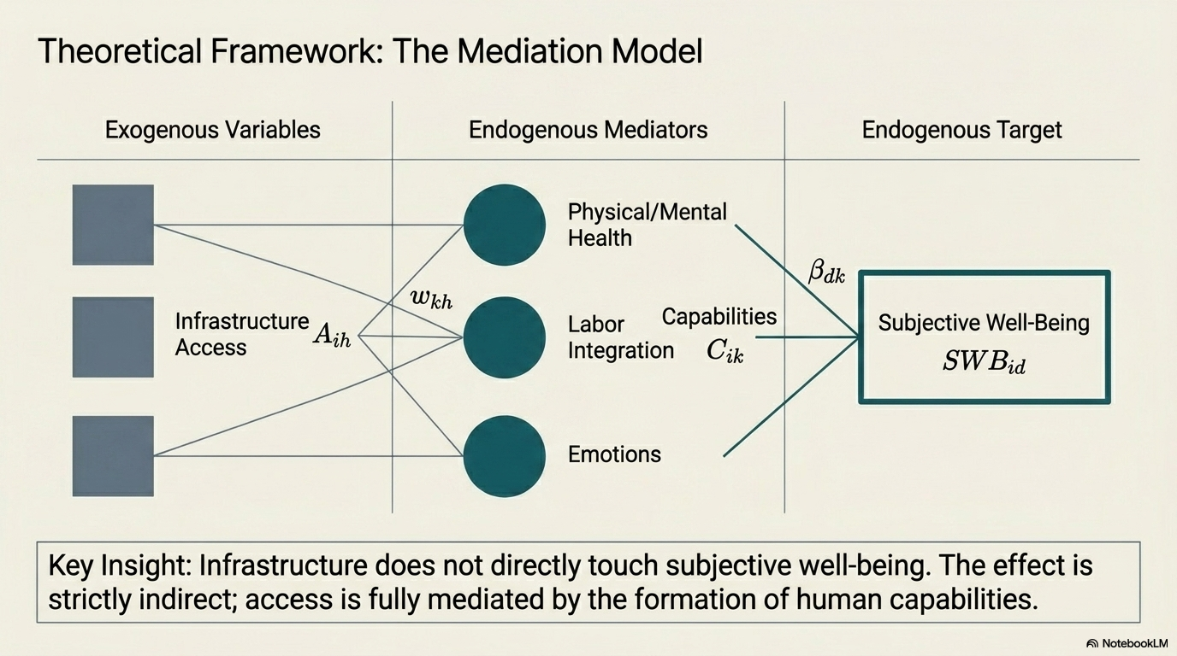

Slide 4
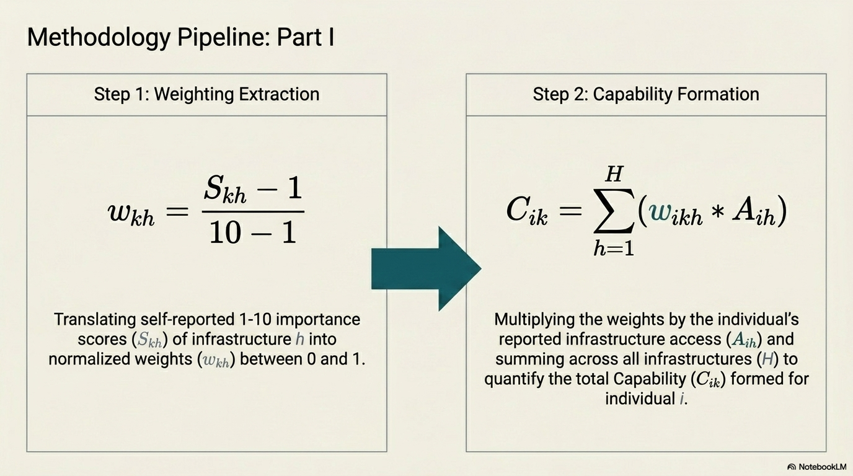

Slide 5
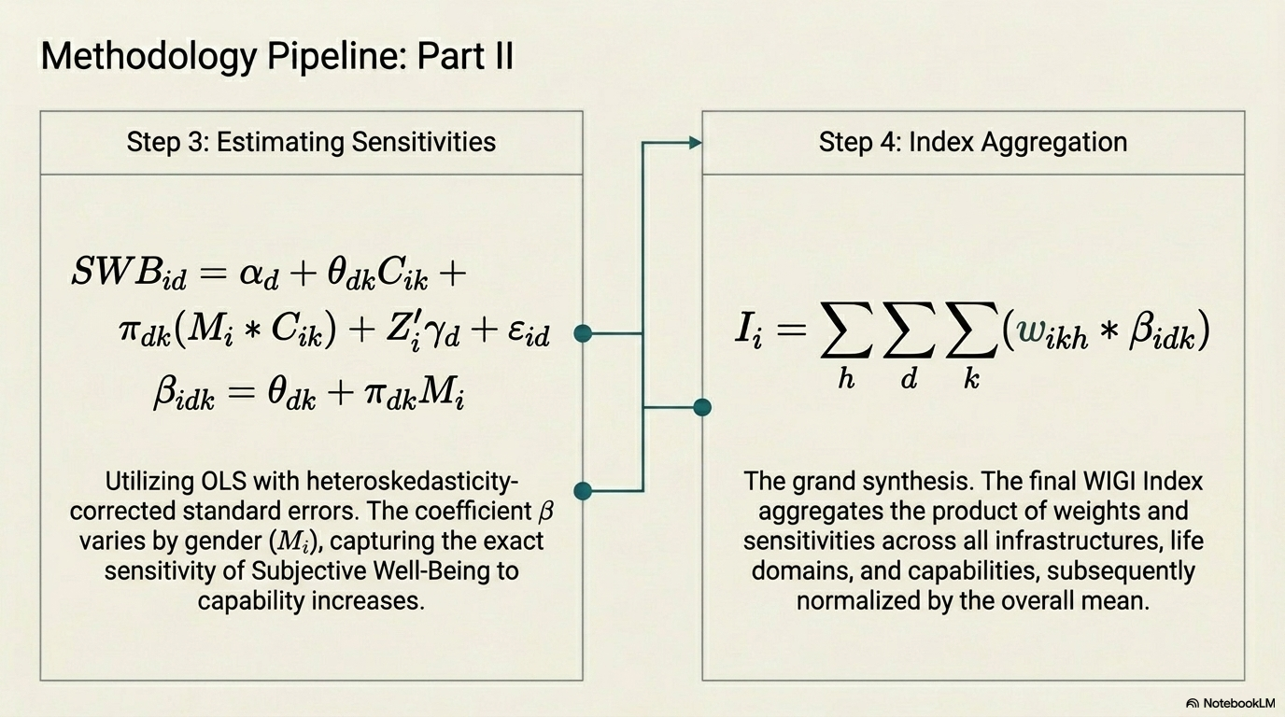

Slide 6
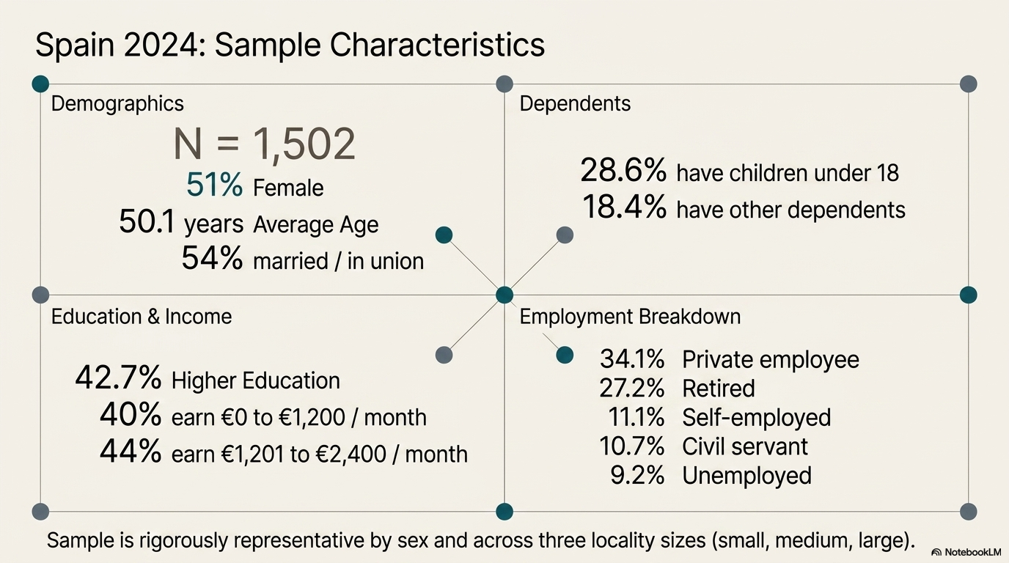
Table 1

Slide 7
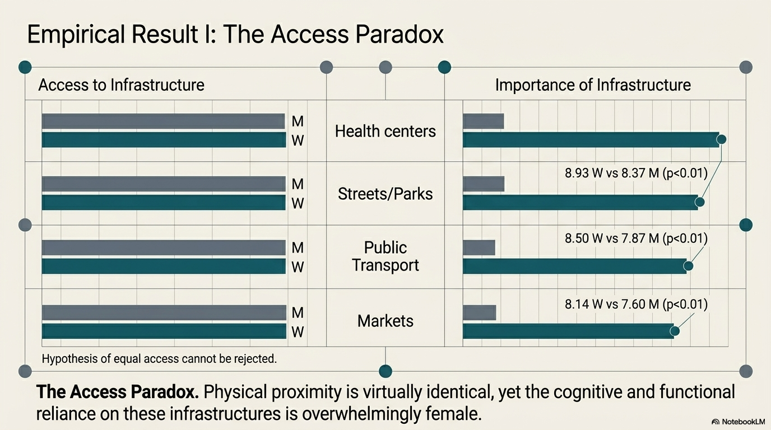
Table 2

Slide 8
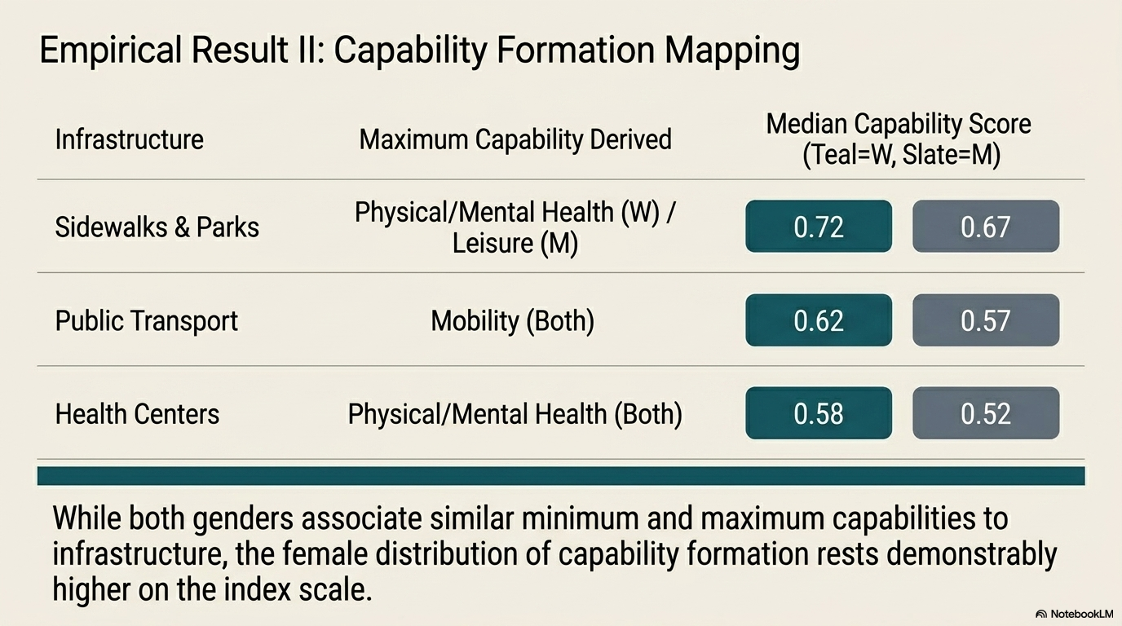
Table 3

Slide 9
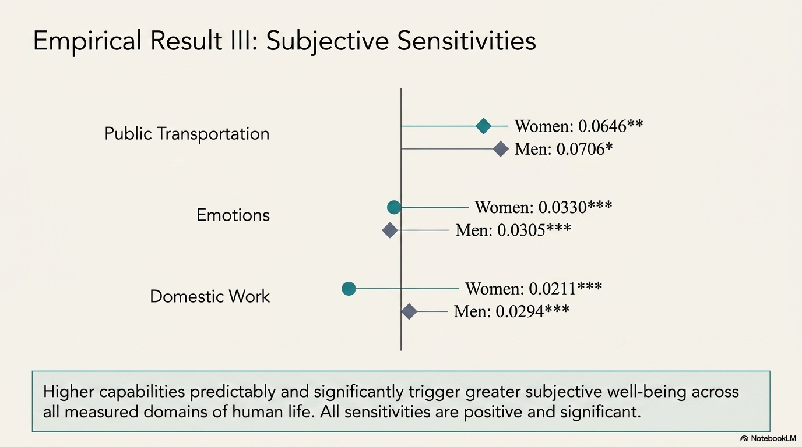
Table 4

Slide 10
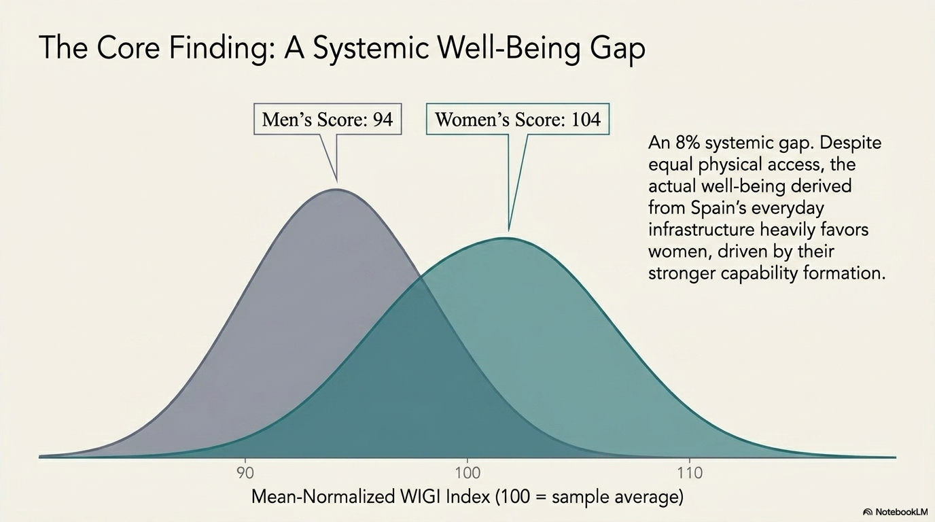
Table 5

Slide 11
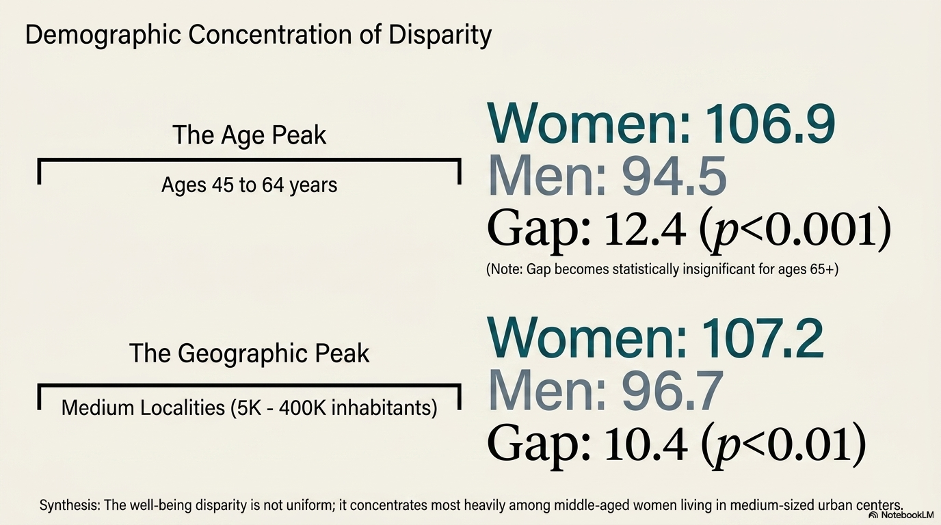
Table 6

Slide 12
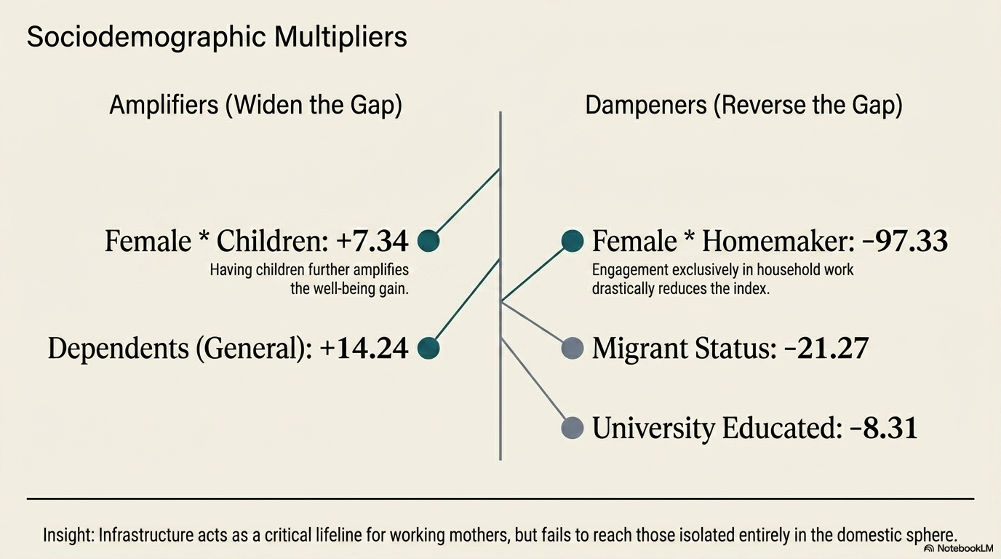
Table 7

Slide 13
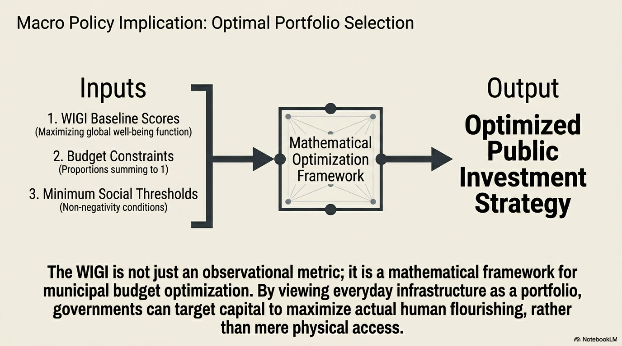

Slide 14
 | Observations | Mean | Std Dev | Minimum | Maximum
Characteristics
Female | 1,502 | 0.5100 | 0.5001 | 0 | 1
Age | 1,502 | 50.1012 | 17.1045 | 18 | 94
Married or in union | 1,495 | 0.5431 | 0.4983 | 0 | 1
Children under 18 years | 1,501 | 0.2865 | 0.4523 | 0 | 1
Other dependents | 1,501 | 0.1845 | 0.3881 | 0 | 1
Religious | 1,471 | 0.6179 | 0.4861 | 0 | 1
Heterosexual | 1,457 | 0.9307 | 0.2541 | 0 | 1
Education
Secondary or less | 1,499 | 0.1755 | 0.3805 | 0 | 1
Intermediate | 1,499 | 0.3976 | 0.4896 | 0 | 1
Higher | 1,499 | 0.4270 | 0.4948 | 0 | 1
Monthly income (euros)
0 to 1,200 | 1,356 | 0.4004 | 0.4902 | 0 | 1
1,201 to 2,400 | 1,356 | 0.4403 | 0.4966 | 0 | 1
More than 2,401 | 1,356 | 0.1593 | 0.3661 | 0 | 1
Employment Status
Students | 1,501 | 0.0420 | 0.2006 | 0 | 1
Retired | 1,501 | 0.2725 | 0.4454 | 0 | 1
Unemployed | 1,501 | 0.0926 | 0.2900 | 0 | 1
Homemaker | 1,501 | 0.0300 | 0.1706 | 0 | 1
Private employee | 1,501 | 0.3411 | 0.4742 | 0 | 1
Civil servant | 1,501 | 0.1073 | 0.3095 | 0 | 1
Self-employed | 1,501 | 0.1113 | 0.3146 | 0 | 1
Table 1
Sociodemographic Characteristics of the Sample for the Survey on Infrastructure for Daily Life from the Feminist Economy of Well-Being 2024

Slide 15
 | Sample | Women | Men | Difference Without controls | Difference With controls
Access to Infrastructure
Childcare centers for children under 3 years | 7.0846 | 7.2647 | 6.9383 | 0.3264** | 0.3454*
Health centers and hospitals | 7.5567 | 7.6501 | 7.4701 | 0.1800 | 0.1292
Care centers for dependent persons | 5.6258 | 5.7153 | 5.5698 | 0.1454 | 0.1292
Streets, sidewalks, lighting, parks and green areas | 7.6533 | 7.7546 | 7.5679 | 0.1866 | 0.1901*
Markets and shopping centers | 7.0662 | 7.1165 | 7.0747 | 0.0418 | -0.0399
Public transportation | 6.4517 | 6.6000 | 6.3420 | 0.2580* | 0.1555
Leisure, cultural and sports facilities | 6.8203 | 6.8366 | 6.8844 | -0.0478 | -0.0805
Industrial parks | 5.6956 | 5.5356 | 5.9113 | -0.3757** | -0.4000***
Importance of Infrastructure
Childcare centers for children under 3 years | 7.7437 | 7.8259 | 7.6571 | 0.1688 | 0.1627
Health centers and hospitals | 9.1643 | 9.2627 | 9.0462 | 0.2165*** | 0.2130***
Care centers for dependent persons | 7.4281 | 7.6232 | 7.2202 | 0.4029** | 0.3997***
Streets, sidewalks, lighting, parks and green areas | 8.6714 | 8.9398 | 8.3777 | 0.5621*** | 0.5518***
Markets and shopping centers | 7.8718 | 8.1451 | 7.6033 | 0.5418*** | 0.5067***
Public transportation | 8.2072 | 8.5079 | 7.8721 | 0.6357*** | 0.6029***
Leisure, cultural and sports facilities | 8.0941 | 8.1872 | 7.9946 | 0.1926* | 0.1865*
Industrial parks | 6.1575 | 5.8987 | 6.4259 | -0.5272*** | -0.5039***
Table 2
Access to and Importance of Everyday Infrastructure in Spain 2024

Slide 16
Infrastructure |  | Minimum |  | Maximum |  | Median
 |  | Score | Capability | Score | Capability | Score
Infant Schools | Women | 0.5710 | Leisure | 0.7549 | Physical and Mental Health | 0.6326
 | Men | 0.4808 | Mobility | 0.7052 | Education | 0.5424
Health Centers and Hospitals | Women | 0.4085 | Leisure | 0.8935 | Physical and Mental Health | 0.5754
 | Men | 0.3825 | Leisure | 0.8495 | Physical and Mental Health | 0.5182
Care Centers for Dependent Persons | Women | 0.5156 | Leisure | 0.6779 | Domestic and Care Work | 0.5773
 | Men | 0.4319 | Labor Market Integration | 0.6480 | Domestic and Care Work | 0.5406
Sidewalks, Streets, Parks, Lighting and Green Areas | Women | 0.4469 | Labor Market Integration | 0.7956 | Physical and Mental Health | 0.7222
 | Men | 0.4309 | Labor Market Integration | 0.7466 | Leisure | 0.6711
Markets and Shopping Centers | Women | 0.4683 | Labor Market Integration | 0.6504 | Leisure | 0.5474
 | Men | 0.4119 | Domestic and Care Work | 0.6104 | Leisure | 0.4908
Public Transportation | Women | 0.5550 | Domestic and Care Work | 0.7577 | Mobility | 0.6287
 | Men | 0.4669 | Emotions | 0.7147 | Mobility | 0.5716
Leisure Areas (theaters, cinemas, sports) | Women | 0.4712 | Labor Market Integration | 0.8126 | Physical and Mental Health | 0.7367
 | Men | 0.4267 | Labor Market Integration | 0.7914 | Physical and Mental Health | 0.7034
Industrial Parks | Women | 0.3888 | Domestic and Care Work | 0.5677 | Labor Market Integration | 0.4384
 | Men | 0.3642 | Domestic and Care Work | 0.6311 | Labor Market Integration | 0.4534
Table 3
Importance of Everyday Infrastructure in the Formation of Minimum, Maximum, and Median Capabilities in Spain 2024

Slide 17
 | Associated Capability Coefficient
Dependent Variable | Women | Men | Observations | R² | F
Satisfaction with:
Health | 0.0085** | 0.0131** | 907 | 0.1419 | 16.4844
Personal relationships | 0.0149*** | 0.0101*** | 1070 | 0.1224 | 14.7644
Education | 0.0162*** | 0.0124*** | 840 | 0.136 | 10.0031
Domestic work | 0.0211*** | 0.0294*** | 1012 | 0.1509 | 13.6414
Paid work | 0.0082*** | 0.0068*** | 1047 | 0.1797 | 15.0603
Economic situation | 0.0079* | 0.0072 | 1053 | 0.2105 | 16.2317
Public transportation | 0.0646** | 0.0706* | 970 | 0.3407 | 45.0008
Free time | 0.0234*** | 0.0191*** | 1058 | 0.2643 | 17.7217
Emotions | 0.0330*** | 0.0305*** | 835 | 0.1825 | 26.3675
Table 4
Sensitivity of Satisfaction with Different Life Domains to Their Associated Capability in Spain 2024

Slide 18
Figure 2.
Kernel distributions of the WIGI Index by sex in Spain 2024

Slide 19
 | Total | Women | Men | Difference | t | p-value
Total | 100.0000 | 104.0957 | 95.7374 | 8.3583 | 3.8852 | 0.0001
Age groups
18 to 30 years | 97.9584 | 102.2096 | 93.8454 | 8.3642 | 1.8883 | 0.0602
31 to 44 years | 103.0347 | 106.9542 | 99.2064 | 7.7478 | 1.8328 | 0.0677
45 to 64 years | 100.7842 | 106.9915 | 94.5541 | 12.4374 | 3.4530 | 0.0006
65 or older | 97.4263 | 99.0163 | 95.4883 | 3.5281 | 0.7161 | 0.4744
Locality size
Less than 5,000 inhabitants | 98.3234 | 100.8430 | 95.9602 | 4.8828 | 1.2473 | 0.2129
5,000 to 400,000 inhabitants | 102.1178 | 107.226 | 96.75941 | 10.4666 | 2.9595 | 0.0032
More than 400,000 inhabitants | 99.5503 | 104.0307 | 94.4160 | 9.6147 | 2.5771 | 0.0103
Table 5
WIGI Indices by Sex, Age Group, and Locality Size in Spain 2024 (Normalized by the Mean)

Slide 20
 | Coefficient | Standard Error | t | P>t
Constant | 122.6748 | 5.416712 | 22.65 | 0
Female | 8.057382 | 2.666863 | 3.02 | 0.003
Female*Children | 7.345348 | 3.364873 | 2.18 | 0.029
Female*Dependents | -12.23564 | 5.661447 | -2.16 | 0.031
Migrant | -21.27246 | 3.501719 | -6.07 | 0
University educated | -8.317137 | 2.241077 | -3.71 | 0
Dependents | 14.23997 | 4.154425 | 3.43 | 0.001
Catholic | 5.129735 | 2.287473 | 2.24 | 0.025
Female*Homemaker | -97.33264 | 40.33779 | -2.41 | 0.016
Homemaker | 84.6504 | 39.68874 | 2.13 | 0.033
Heterosexual | -7.508588 | 4.215608 | -1.78 | 0.075
Peripheral area | 5.249959 | 2.824421 | 1.86 | 0.063
Madrid | -7.240334 | 4.124433 | -1.76 | 0.079
Andalusia | -5.708124 | 2.687667 | -2.12 | 0.034
n | 1,309
R-squared | 0.0781
Adj R-squared | 0.0688
Table 6
Differences in WIGI Indices by Sex and Other Sociodemographic Conditions in Spain 2024 (Normalized by the Mean), Controlling for Sociodemographic Conditions
Source: Survey on Infrastructure for Daily Life from the Feminist Economy of Well-Being 2024, University of Murcia

