Slide 1
Infrastructure Access and Subjective Well-Being: Exploring Gendered Effects Through the Capability Approach
Gloria Alarcón García
José Daniel Buendía Azorín
Mª del Mar Sánchez de la Vega
Universidad de Murcia
Junio, 2026

Slide 2
INTRODUCTION
Measuring human and economic development and societal progress solely in terms of income is inadequate (UNDP, 2009, 2010; OECD, 2013a, 2013b; European Commission, 2013; OECD, 2023)
New methodologies have been developed to assess well-being beyond monetary income, incorporating both objective and subjective measures
Capability Approach (CA) (Sen 1980, 1985 and 1985a; Nussbaum, 2002 and 2009):
  Human well-being and development should not be measured in terms of available resources, but rather in terms of what people are capable of doing or being
Subjective Well-being (SWB) (Veenhoven (1991, 1996):
  Asking about their concept of well-being without judging it, since it is people who experience well-being in a vital way
Notes:
Para ello, voy a organizar esta presentación haciendo una breve síntesis de las características de algunos enfoques alternativos, la descripción de los datos y la propuesta de estimación empleada, los resultados obtenidos y las principales conclusiones.

Slide 3
A feminist economics Well-being indicator: merging CA and SWB
INTRODUCTION
THEORY | CAPABILITY APPROACH | SUBJECTIVE WELL-BEING
Well-being Type | Eudemonic Well-being | Hedonic Well-being
Type | Objective | Subjective
Measurement | Measuring development from a list of capabilities | Directly asking people about their well-being experiences
The integration of these two approaches enables a more comprehensive assessment of well-being and that is our proposal:
  While CA focuses on expanding opportunities and removing constraints,
  SWB captures individuals lived experiences and perceptions of their circumstances
  (Muffles and Heady, 2013; Arita Watanawe, 2005, 2013; Comim, 2005; Graham and Nikolova, 2015)

Slide 4
A feminist economics Well-being indicator on infrastructure
LITERATURE REVIEW AND THEORETICAL FRAMEWORK
Feminist economists have long argued for recognising the significance of appropriate infrastructure in advancing women’s autonomy and realising greater gender equality (Elson,1995; Waring, 2016)
Link between infrastructure and the reduction of individual income inequality (Calderon & Servén, 2004)
Incorporating gender dimensions into infrastructure planning is crucial not only for individual well-being but also for promoting inclusive and sustainable development (Alarcón-García & Fernandez-Sabiote, 2014; Alarcón-García, 2023; Small & Van der Meulen, 2023)

Slide 5
Data and Metodology
Data:
- survey “Infrastructure for Everyday Life and Well-Being”, 2023*
- population of both genders, over 18 and residents in SPAIN (1502 Individuals)
- four main parts:
(a) General Background Information
(b) Importance, access, satisfaction and quality of several types of infrastructure
(c) Importance of infrastructure in 6 different capabilities (CA) (Physical and mental health, Social relationships, Education, Care and domestic work, Employment, ECONOMIC SITUATION)
(d) SWB related questions and scales
Everyday life infrastructure (8): I1:children’s schools; I2: Health centers and hospptals; I3:Centres for people with dependencies;I4: Sidewalks, pedestrians' paths, Parks, Street lights and green areas; I5: Market and shoping centers; I6: Public transport; I7: Leisure areas (cultural and sport) and I8: Industrial parks
*Infraestructuras para la Vida cotidiana desde la Economía Feminista del Bienestar PID2022-141305OB-I00, Plan Estatal de Investigación Científica, Técnica y de Innovación 2021-2023

Slide 6
Data and Metodology
Distribution by sex and age of the respondents
Source: Own elaboration based on the survey “Infrastructure for Everyday Life and Well-Being”
Fuente: Elaboración propia a partir de OFUM

Slide 7
Data and Metodology
Variable | Mean | Standard deviation | Minimum | Maximum | #Obs.
Gender | 1.51 | 0.50 | 1 | 2 | 1502
Age | 50.10 | 17.10 | 18 | 94 | 1502
Education | 4.74 | 1.38 | 1 | 6 | 1499
Subjective Well-being | 7.79 | 1.65 | 1 | 10 | 1501
Labour situation | 4.48 | 1.69 | 1 | 9 | 1501
Income | 4.68 | 1.92 | 1 | 9 | 1343

Slide 8
HYPOTHESES
Data and Metodology
H1: Access to infrastructure improves subjective well-being indirectly through its positive effect on capabilities. This mediating relationship is tested using a statistical mediation model.
H2: The effect of infrastructure access (except industrial parks) on subjective well-being is greater for women than for men, reflecting gender-based differences in baseline capability conditions and structural constraints.
H3: The contribution of each infrastructure h (except industrial parks) to the improvement of each capability k is greater for women than for men. This reflects the potentially transformative role of infrastructure in enhancing women's capabilities.
H4: The achieved level of each capability k, as enabled or supported by infrastructure, is higher for women than for men, suggesting a differential impact of infrastructure across gender lines.

Slide 9
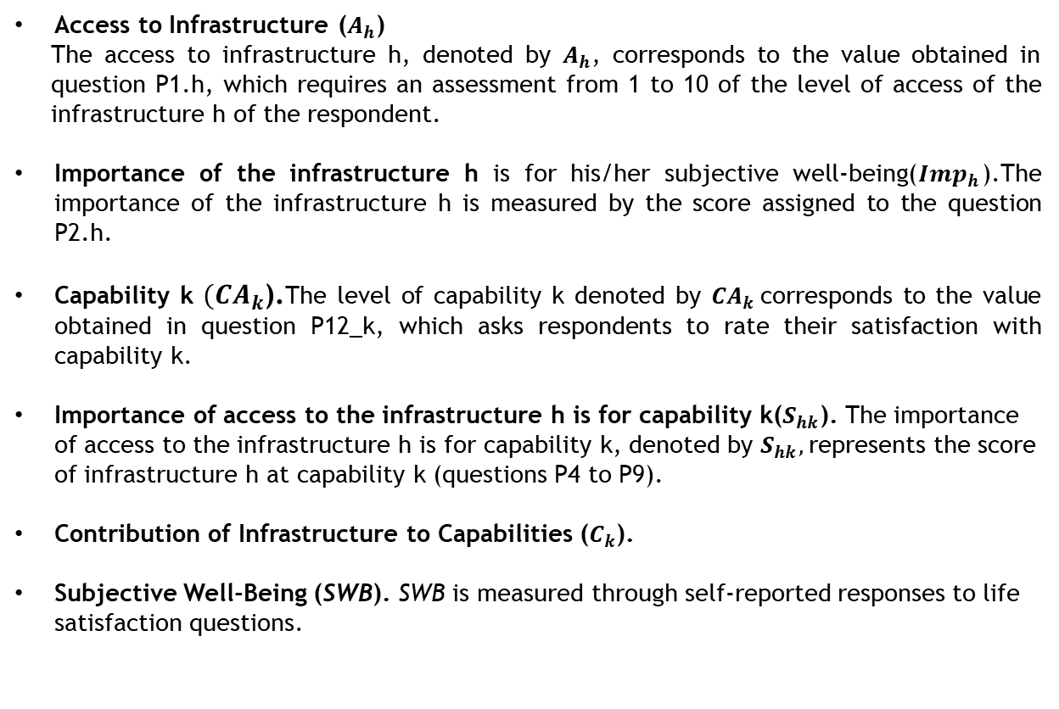
Data and Metodology
Variables and Operational Definitions
Access to Infrastructure ($A_{h}$)
The access to infrastructure h, denoted by $A_{h}$, corresponds to the value obtained in question P1.h, which requires an assessment from 1 to 10 of the level of access of the infrastructure h of the respondent.
Importance of the infrastructure h is for his/her subjective well-being(${Imp}_{h}$).The importance of the infrastructure h is measured by the score assigned to the question P2.h.
Capability k ${(CA}_{k}$).The level of capability k denoted by ${CA}_{k}$corresponds to the value obtained in question P12_k, which asks respondents to rate their satisfaction with capability k.
Importance of access to the infrastructure h is for capability k($S_{hk}$). The importance of access to the infrastructure h is for capability k, denoted by $S_{hk},$represents the score of infrastructure h at capability k (questions P4 to P9).
Contribution of Infrastructure to Capabilities ($C_{k}$).
Subjective Well-Being (SWB). SWB is measured through self-reported responses to life satisfaction questions.

Slide 10
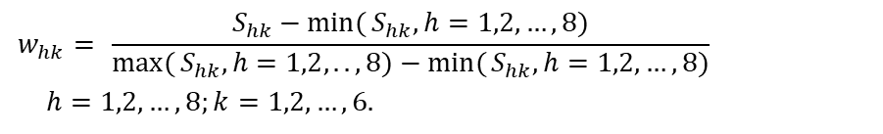

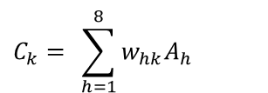
Data and Metodology
$C_{k}$: impact that infrastructure have on the capability k.
$$w_{hk}= \frac{S_{hk}−\min{(}S_{hk},h=1,2,…,8)}{\max{(}S_{hk},h=1,2,..,8)−\min{(}S_{hk},h=1,2,…,8)}$$
$$h=1,2,…,8;k=1,2,…,6.$$
[1]
$$C_{k}= \sum_{h=1}^{8}{w_{hk}A_{h}}$$
[2]

Slide 11
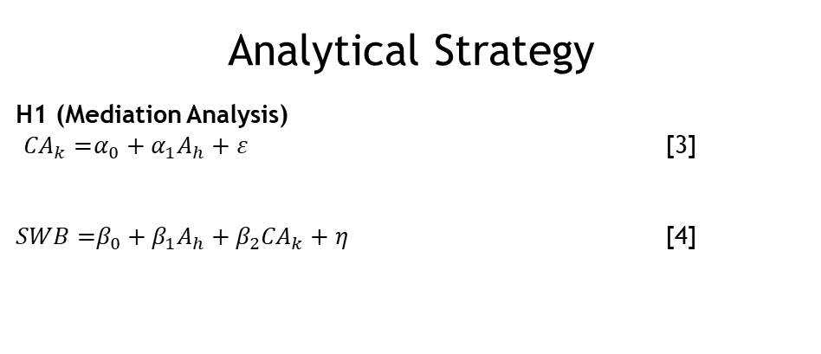
Data and Metodology
Analytical Strategy
H1 (Mediation Analysis)
${CA}_{k}=$​$α_{0}+α_{1}A_{h}+ε$ [3]
$SWB=$​$β_{0}+β_{1}A_{h}+β_{2}{CA}_{k}+η$ [4]

Slide 12
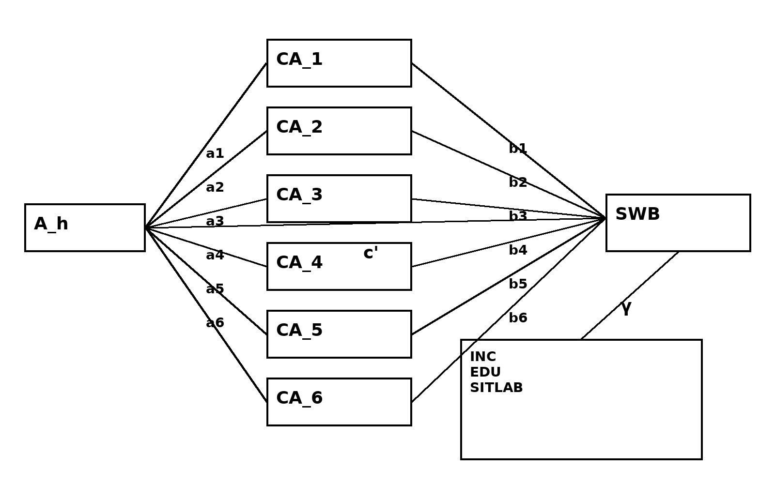
Data and Metodology

Slide 13
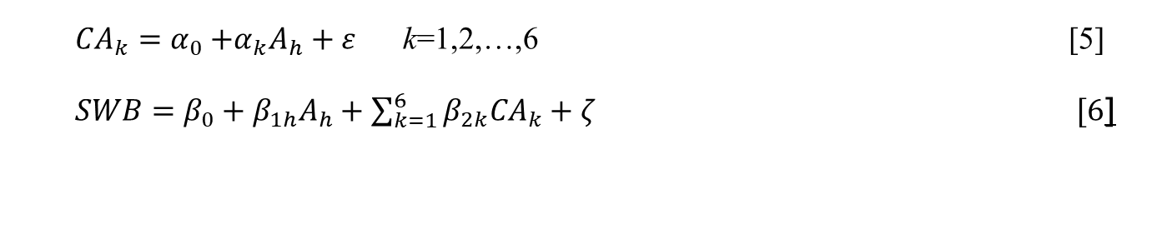
Data and Metodology
${CA}_{k}=α_{0}+$​${α_{k}A}_{h}+ε$ k=1,2,…,6 [5]
$SWB=​β_{0}+{β_{1h}A}_{h}+\sum_{k=1}^{6}{β_{2k}{CA}_{k}}+ζ [6$]

Slide 14

Data and Metodology
H2–H4 (Gender Differences and Interaction Effects)
H2:
${Imp}_{h}=α_{0}+α_{1}CODSEXO+β_{1}INC+β_{2}EDU+β_{3}SITLAB +ε , h=1,2,...,8$ [7]
H3:
$$w_{hk}A_{h}=α_{0}+α_{1}CODSEXO+β_{1}INC+β_{2}EDU+β_{3}SITLAB +ε ,$$
$k=1,2,…,6; h=1,2,...,8$. [8]
H4:
$C_{k}=α_{0}+α_{1}CODSEXO+β_{1}INC+β_{2}EDU+β_{3}SITLAB +ε , k=1,2,...,6.$ [9]
.

Slide 15
RESULTS
Table 1. Direct and indirect effects of the mediation model
 | Infrastructure
 | I1 | I2 | I3 | I4 | I5 | I6 | I7 | I8
Effect | β | β | β | β | β | β | β | β
Direct | 0.01 | -0.023 | 0.027 | -0.003 | -0.045 | 0.002 | 0.019 | 0.028
Indirect 1 | 0.025*** | 0.031*** | 0.030*** | 0.033*** | 0.035*** | 0.023** | 0.041*** | 0.028***
Indirect 2 | 0.014* | 0.013* | 0.010* | 0.013* | 0.014* | 0.007* | 0.015* | 0.012*
Indirect 3 | 0.012* | 0.014* | 0.010* | 0.012* | 0.010* | 0.010* | 0.013* | 0.011*
Indirect 4 | 0.012** | 0.017** | 0.012* | 0.017** | 0.016** | 0.011* | 0.017** | 0.014**
Indirect 5 | 0.011* | 0.018** | 0.013* | 0.011* | 0.013* | 0.008* | 0.015* | 0.012*
Indirect 6 | 0.012** | 0.015** | 0.017** | 0.014** | 0.013** | 0.012** | 0.017** | 0.013**
Total | 0.096*** | 0.086*** | 0.119*** | 0.097*** | 0.056* | 0.072** | 0.136*** | 0.117***

Slide 16
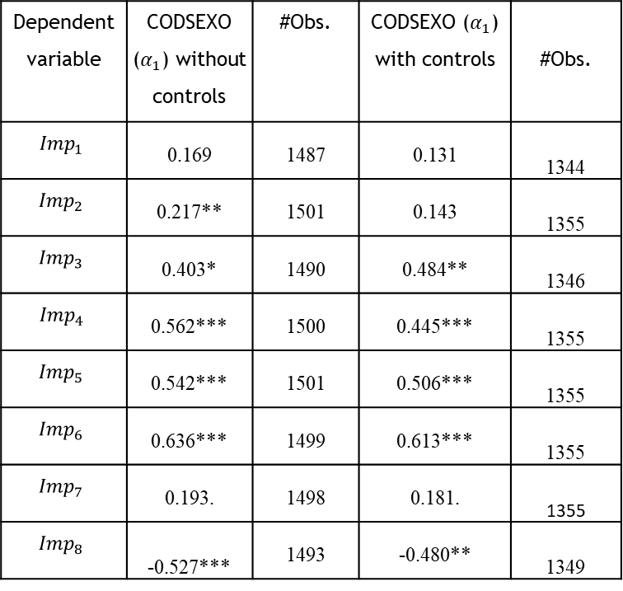
RESULTS
Table 2. Effect of Gender on Importance (with and without controls)
Dependent variable | CODSEXO ($α_{1}$) without controls | #Obs. | CODSEXO ($α_{1}$) with controls | #Obs.
$${Imp}_{1}$$ | 0.169 | 1487 | 0.131 | 1344
$${Imp}_{2}$$ | 0.217** | 1501 | 0.143 | 1355
$${Imp}_{3}$$ | 0.403* | 1490 | 0.484** | 1346
$${Imp}_{4}$$ | 0.562*** | 1500 | 0.445*** | 1355
$${Imp}_{5}$$ | 0.542*** | 1501 | 0.506*** | 1355
$${Imp}_{6}$$ | 0.636*** | 1499 | 0.613*** | 1355
$${Imp}_{7}$$ | 0.193. | 1498 | 0.181. | 1355
$${Imp}_{8}$$ | -0.527*** | 1493 | -0.480** | 1349

Slide 17
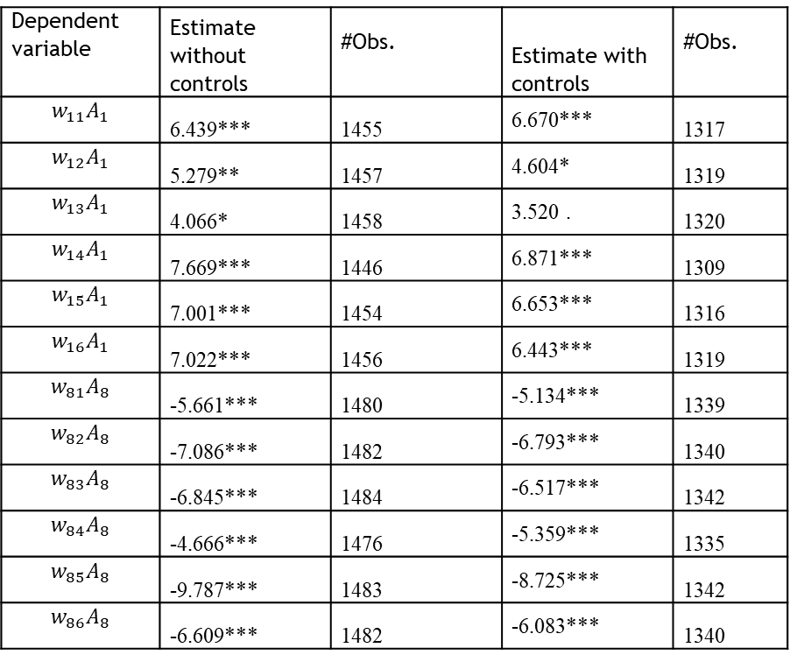
RESULTS
Table 3. Impact of infrastructure h on capability k, $w_{hk}A_{h}$ (without and with controls)
Dependent variable | Estimate without controls | #Obs. | Estimate with controls | #Obs.
$$w_{11}A_{1}$$ | 6.439*** | 1455 | 6.670*** | 1317
$$w_{12}A_{1}$$ | 5.279** | 1457 | 4.604* | 1319
$$w_{13}A_{1}$$ | 4.066* | 1458 | 3.520 . | 1320
$$w_{14}A_{1}$$ | 7.669*** | 1446 | 6.871*** | 1309
$$w_{15}A_{1}$$ | 7.001*** | 1454 | 6.653*** | 1316
$$w_{16}A_{1}$$ | 7.022*** | 1456 | 6.443*** | 1319
$$w_{81}A_{8}$$ | -5.661*** | 1480 | -5.134*** | 1339
$$w_{82}A_{8}$$ | -7.086*** | 1482 | -6.793*** | 1340
$$w_{83}A_{8}$$ | -6.845*** | 1484 | -6.517*** | 1342
$$w_{84}A_{8}$$ | -4.666*** | 1476 | -5.359*** | 1335
$$w_{85}A_{8}$$ | -9.787*** | 1483 | -8.725*** | 1342
$$w_{86}A_{8}$$ | -6.609*** | 1482 | -6.083*** | 1340

Slide 18
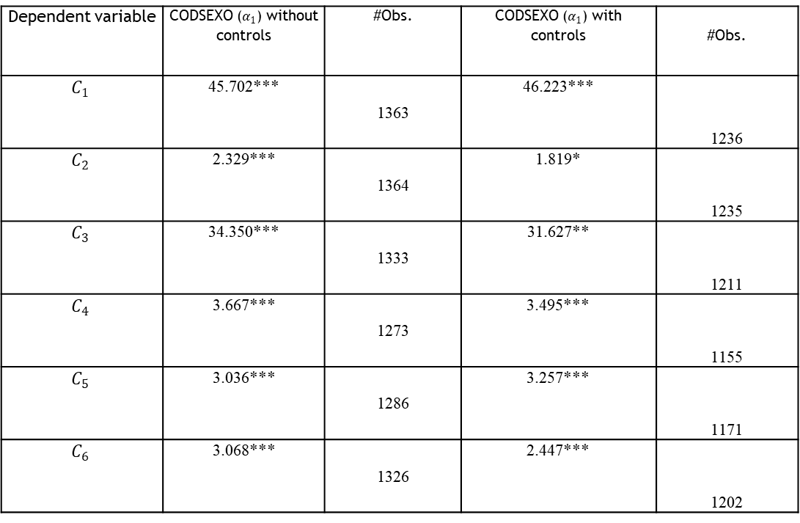
RESULTS
Table 4. Impact of infrastructure on capability k (with and without controls)
Dependent variable | CODSEXO ($α_{1}$) without controls | #Obs. | CODSEXO ($α_{1}$) with controls | #Obs.
$$C_{1}$$ | 45.702*** | 1363 | 46.223*** | 1236
$$C_{2}$$ | 2.329*** | 1364 | 1.819* | 1235
$$C_{3}$$ | 34.350*** | 1333 | 31.627** | 1211
$$C_{4}$$ | 3.667*** | 1273 | 3.495*** | 1155
$$C_{5}$$ | 3.036*** | 1286 | 3.257*** | 1171
$$C_{6}$$ | 3.068*** | 1326 | 2.447*** | 1202

Slide 19
Conclusions
Conclusions
The results support H2, as the estimated coefficients reveal that, with the exception of industrial parks, the contribution of infrastructure access to subjective well-being is systematically greater for women than for men.
Third, the evidence also confirms H3. The regression results indicate that the contribution of each type of infrastructure to the improvement of capabilities is generally stronger for women than for men. Except in the case of industrial parks, all coefficients are positive and, in most cases, statistically significant. These findings highlight the transformative role that infrastructure can play in enhancing women’s capabilities and reducing gender-based inequalities in access to opportunities.
The mediation analysis confirms H1, showing that access to infrastructure exerts a significant indirect effect on subjective well-being through the enhancement of capabilities.

Slide 20
Conclusions
Finally, the results provide robust support for H4. The positive and highly significant coefficients associated with the aggregate impact of infrastructures on capabilities demonstrate that the achieved level of capabilities is higher for women than for men when supported by infrastructure provision. This suggests that infrastructures generate differentiated benefits across gender groups, contributing more intensively to the expansion of women’s capabilities.
The results emphasize the importance of incorporating a gender-sensitive perspective into infrastructure planning and public policy design, given the stronger positive effects observed for women across most of the dimensions analyzed. Furthermore, the evidence suggests that infrastructure policies can play a key role in reducing structural inequalities by disproportionately improving women’s capabilities and well-being outcomes. In this sense, the study contributes to the literature by highlighting the central role of capabilities as the channel through which infrastructure affects subjective well-being, while also demonstrating that these effects are not gender neutral.

