Slide 1

Infrastructure as a Structural
Determinant of Violence Against
Women: Perceptions and Evidence
from Spain
Gloria Alarcón, Laura De Pablos, María Carmen García-Centeno
Notes:
Cover slide for the 1st International Symposium.

Slide 2



OBJECTIVES
Analyses the significance of different types of infrastructure (healthcare, care, transport, economic, cultural, sports, etc.) in the perception of gender-based violence.
Factors influencing the significance of infrastructure in relation to gender-based violence: personal factors (gender, age, marital status); economic factors (income, employment status); educational factors, …
1st International Symposium “Infrastructures for Everyday Life, Social Well-being and New Metrics for Public Decision-Making”
Notes:
Standard content slide. Footer text is editable.

Slide 3
STRUCTURE OF THE INTERVENTION
LITERATURE REVIEW
METHODOLOGY AND DATA
DESCRIPTIVE ANALYSIS OF OBSERVED AND LATENT VARIABLES
MODELS AND RESULTS

Slide 4
1. LITERATURE REVIEW
The majority of studies focus on the factors associated with the factors likelihood of experiencing gender-based violence (Small et al., 2023; Guaita-Fernández et al., 2024; Ricoy-Cano et al., 2025) | The importance of public transport. Areas with a public transport stop have a significantly lower prevalence of gender-based violence compared to areas without a metropolitan public transport stop (Roman and Reid, 2012).
Investment in infrastructure—physical, social and digital, etc.—as a key factor in both the perpetuation and prevention of gender-based violence (Tiznado-Aitken et al., 2024). | Poor sanitation and a lack of safe public spaces increase the risk of gender-based violence (Mwazvita et al., 2020).
Gender-based violence experienced on public transport itself (Infante-Vargas et al. (2022), Tiznado-Aitken et al. (2024), Ison (2024), Useche (2024)). Sexual harassment, physical and verbal assaults, threats, etc | Lighting and urban design of spaces reduce perceptions of insecurity (Various Authors, 2023)

Slide 5
2. DATEBASE AND METHODOLOGY
Datebase
Methodology
“Survey on Infrastructure for Everyday Life”, research project PID 2022-141305OB-100.
The target is the general population of both sexes, aged 18 and over, residing in Spain.
The strata accccording to the size of the municipalities’ divided into three categories: 5,000 inhabitants or fewer; between 5,001 and 400,000 inhabitants; and more than 400,000 inhabitants.
Structural equation modelling, a multivariate statistical technique that combines multiple linear regression models with factor analysis. Structure analysis to test for the existence of causality between observed and latent variables.
Probabilistic models.

Slide 6
3. OBSERVED, PERSONAL, SOCIAL AND ECONOMIC VARIABLES
Personal and Social Variables:
Gender: categorical variable coded as Male = 1; Female = 2
Age: numerical variable
Autonomous Communities (Comunidades Autónomas)
Marital status: categorical variable coded as married or cohabiting = 1; single = 2; widowed, separated, or divorced = 3
Place of residence: categorical variable including city centre, rural area, hamlet, residential development, and other
Highest level of education completed: primary education; secondary education; upper secondary education (baccalaureate), vocational training, and university education
Economic Variables
Net disposable income after deductions: numerical variable treated as continuous in the models. For descriptive purposes, income is grouped into ten categories ranging from EUR 300 to EUR 6,000 or more per month.
Employment status:
  Self-employed with employees
  Self-employed without employees
  Public sector employee (civil servant)
  Private sector employee
  Retired / pensioner
  Homemaker
  Student
  Unemployed

Slide 7
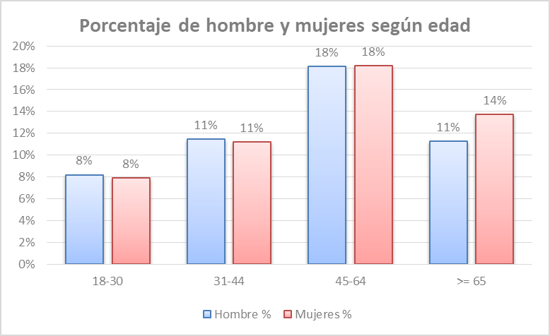
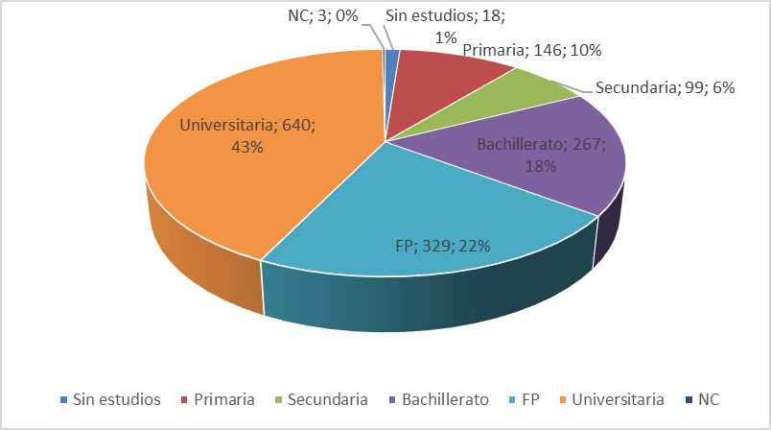
3. DESCRIPTIVE STATISTICS: SOME EXAMPLES

Slide 8
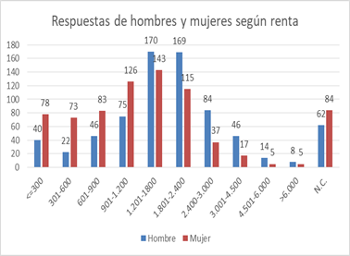
3. DESCRIPTIVE STATISTICS: SOME EXAMPLES

Slide 9
3. UNOBSERVED, PERSONAL, SOCIAL AND ECONOMIC VARIABLES
Latent variables
The importance of infrastructure in gender-based violence
Access to infrastructure
The importance respondents attach to infrastructure
The infrastructure dimensions considered are:
Childcare centres
Health centres and hospitals
Facilities for people with care dependencies
Sidewalks, pedestrian streets, parks, public lighting, and green areas
Markets and shopping centres
Public transportation
Leisure areas
Industrial parks

Slide 10
3. DESCRIPTIVE STATISTICS FOR LATENT VARIABLES: The importance of infrastructure and perceptions of gender-based violence
Health centres and hospitals, childcare centres, and sidewalks, pedestrian streets, and public lighting : highest mean
industrial parks and markets and shopping centres receive the lowest
Gender gap is particularly pronounced for health-related infrastructures: 19% of women assign the maximum score (10), compared to 12% of men. Early childhood education centres, where 15% of women and 12% of men assign the highest possible rating.
Women tend to value infrastructures highly in themselves, regardless of their specific influence on gender-based violence, and only a small proportion of women assign them no importance at all. Only 6% of women assign no importance to the existence of early childhood education centres, 5% do so for care facilities for dependent persons, and 8% for industrial parks.

Slide 11
3. DESCRIPTIVE STATISTICS FOR LATENT VARIABLES: The importance of infrastructure and perceptions of gender-based violence
Low and medium income levels demonstrate a higher perception of the importance of infrastructure.
University education higher perception (FP (3)).
Individuals living in rural areas and hamlets also attribute greater importance to infrastructure in relation to gender-based violence.
Married more than singles or divorces
Age and income does not appear to be a determining factor.

Slide 12
3. DESCRIPTIVE ACCESS AND IMPORTANCE INDICES FOR INFRASTRUCTURE
ACCES
Women report higher levels of access across nearly all types of infrastructure.
Access to childcare centres shows high values for the mean, median, and mode (7, 8, and 10, respectively). A similar situation is observed for health centres and hospitals, sidewalks and public lighting, and markets and shopping centres.
By contrast, the mean value for public transportation care dependencies and to industrial parks. is lower, suggesting that access is less fluid.
IMPORTANCE
Women assign substantially higher importance to almost all types of infrastructure considered, with the exception of industrial parks. It is common for women to assign the maximum score of 10, while very few women indicate that infrastructure is entirely unimportant.
Mean and the modal values are higher than those observed for the access variable, indicating that respondents generally assign greater importance to infrastructure than the level of access they actually experience.

Slide 13
4. MODELOS Y RESULTADOS
2º model
1º model
Dependent variable: the importance of infrastructure in gender-based violence
Independent variables, the latent variables ‘access’ (ACCN) and ‘importance of infrastructure’ (IMPN), Observed variables: age, income, gender, marital status, educational attainment, place of residence and employment status. All variables are categorical except for income and age, which are numerical variables
The second estimated model includes, in addition to the variables already considered in the first model, a set of dummy variables to identify the respondent’s region of residence. The aim is to examine whether there are distinct regional patterns in the perception of the importance of infrastructure in relation to gender-based violence.

Slide 14
4.RESULTS
The infrastructure importance index (IMPN) shows a statistically significant and substantively meaningful effect.
In contrast, the access index (ACCN) does not reach statistical significance
Age and income are not statistically significant.
Secondary education, university education and upper secondary education show statistically significant effects and positive influence.
Gender is statistically significant women have approximately a 24% higher probability of perceiving the importance of infrastructures in the context of gender-based violence compared to men.
Categories related to marital status, residential location, and employment status are not statistically significant.

Slide 15
5.CONCLUSIONS
CONTRIBUTIONS
This study pursues a particularly novel objective and, as a result, draws on a limited body of prior literature.
The reference variable based on a self-designed survey: the importance of infrastructure and perceptions of gender-based violence ( and the construction latent variable)
The calculation of composite indices of access and importance the study of determining factors and the descriptive statistics.
Relevance of the results from a gender perspective

Slide 16
5.CONCLUSIONS
The latent variables show:
Women report higher level of The importance of infrastructure and perceptions of gender-based violence
Women report higher levels of access across nearly all types of infrastructure
Women also report higher levels of importance across nearly all types of infrastructure
Models resuts
Positive influence
Sex female more than male
The infrastructure importance index (IMPN) shows a statistically significant and substantively meaningful effect.
Education secondary education and university education
CCAA without important diferents

