Slide 1

PHYSICAL AND MENTAL HEALTH AT THE INTERSECTION OF CAPABILITIES AND SUBJECTIVE WELL-BEING: EVIDENCE FROM THE WIGI METRIC-QUESTION
Gloria Alarcón, Laura De Pablos, María Carmen García-Centeno
Notes:
Cover slide for the 1st International Symposium.

Slide 2



OBJECTIVE
The objective: to examine subjectively assessed capabilities are associated with satisfaction with physical and mental health. T
The analysis employs a hybrid metric-question derived from the WIGI CA–SWB framework
(“Survey on Infrastructure for Everyday Life”, conducted as part of research project PID 2022-141305OB-100, P12).
1st International Symposium “Infrastructures for Everyday Life, Social Well-being and New Metrics for Public Decision-Making”
Notes:
Standard content slide. Footer text is editable.

Slide 3
CONCEPTUAL FRAMEWORK
Well-being must be understood as a relationship across three levels:
    The material conditions that sustain everyday life,
    The substantive capabilities that these conditions enable,
    The subjective evaluation individuals make regarding the extent to which such capabilities are effectively realised in their
Physical and mental health isn´t considered as a purely medical variable, nor as a simple dimension of individual satisfaction.
Neither does it seek to demonstrate that infrastructures directly determine physical and mental health outcomes.
Mental and physical health, conceptualized as a catalytic capability within the WIGI Capability–Subjective Well-Being (CA–SWB) framework.

Slide 4
STRUCTURE OF THE INTERVENTION
LITERATURE REVIEW
METHODOLOGY AND DATA
DESCRIPTIVE ANALYSIS OF OBSERVED AND LATENT VARIABLES
MODELS AND RESULTS

Slide 5
1. REVIEW (Gender perspective)

Slide 6
1. REVIEW(Gender perspective)

Slide 7
1. REVIEW(Gender perspective)
This is a relevant background supporting the objective of this paper.
The present work try to advance. Specifically, it aims to empirically assess the extent to which the subjective perception of different capabilities

Slide 8
2. DATEBASE AND METHODOLOGY
Datebase
Methodology
“Survey on Infrastructure for Everyday Life”, conducted as part of research project PID 2022-141305OB-100.
The target population for this study is the general population of both sexes, aged 18 and over, residing in Spain.
The strata are formed according to the size of the municipalities’ population, divided into three categories: 5,000 inhabitants or fewer; between 5,001 and 400,000 inhabitants; and more than 400,000 inhabitants.
Structural equation modelling: multivariate statistical technique that combines multiple linear regression models with factor analysis. It enables the study of the relationship between latent variables and observed variables. It is a multivariate statistical tool that uses covariance structure analysis to test for the existence of causality between observed and latent variables.
A multiple linear regression model

Slide 9
3. DEPENDENT VARIABLE
The variable P12N_1 measures the level of satisfaction with physical and mental health on a scale from 1 to 10, where 1 indicates very low satisfaction and 10 very high satisfaction.
This variable should not be interpreted as a measure of clinical health or as an indicator of general subjective well-being
P12 does not measure “subjective well-being” Instead, it measures subjective satisfaction with substantive capabilities.
The P12 variable integrates both dimensions by eliciting subjective assessments of objectively relevant capabilities.
Also variables P12N_2 to P12N_9 should not be understood as simple objective indicators, but as subjective evaluations of capabilities associated with social relationships, education, caregiving, employment, economic situation, mobility, leisure time, and emotional expression.

Slide 10
3.DESCRIPTIVE. DEPENDENT VARIABLE
Responses are highly concentrated in the upper end of the scale. In particular, scores of 7 and 8 are the most frequent, accounting for 20.64% and 26.56% of responses, respectively. These are followed by the highest ratings (9 and 10), which together represent more than one-third of the sample (13.91% and 18.38%, respectively).
Predominantly positive self-perception of physical and mental health in the sample, with a distribution skewed towards higher values
The women self-perception is worse, but only moderate gender differences.

Slide 11
3. INDEPENDENT PERSONAL, SOCIAL AND ECONOMIC VARIABLES
Personal and Social Variables:
Gender: categorical variable coded as Male = 1; Female = 2
Age: numerical variable
Marital status: categorical variable coded as married or cohabiting = 1; single = 2; widowed, separated, or divorced = 3
Place of residence: categorical variable including city centre, rural area, hamlet, residential development, and other
Highest level of education completed: primary education; secondary education; upper secondary education (baccalaureate), vocational training, and university education
Economic Variables
Net disposable income after deductions: numerical variable treated as continuous in the models. For descriptive purposes, income is grouped into ten categories ranging from EUR 300 to EUR 6,000 or more per month.
Employment status:
  Self-employed with employees
  Self-employed without employees
  Public sector employee (civil servant)
  Private sector employee
  Retired / pensioner
  Homemaker
  Student
  Unemployed

Slide 12
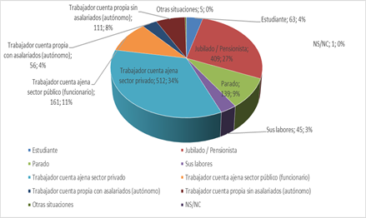
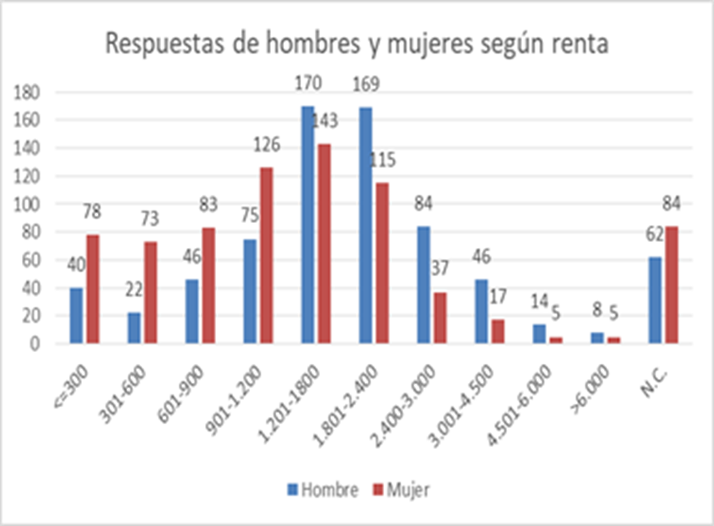
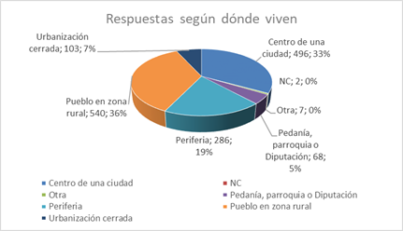
3. DESCRIPTIVE STATISTICS: SOME EXAMPLES
LABOR SITUATION
INCOME. GENDER

Slide 13
3. UNOBSERVED, PERSONAL, SOCIAL AND ECONOMIC VARIABLES
Latent variables
Access to infrastructure
The importance respondents attach to infrastructure
The infrastructure dimensions considered are:
Childcare centres
Health centres and hospitals
Facilities for people with care dependencies
Sidewalks, pedestrian streets, parks, public lighting, and green areas
Markets and shopping centres
Public transportation
Leisure areas
Industrial parks

Slide 14
3. DESCRIPTIVE STATISTICS FOR LATENT VARIABLES:

Slide 15
3. DESCRIPTIVE ACCESS AND IMPORTANCE INFRASTRUCTURE
ACCES
Women report higher levels of access across nearly all types of infrastructure.
Access to childcare centres shows high values for the mean, median, and mode (7, 8, and 10, respectively). A similar situation is observed for health centres and hospitals, sidewalks and public lighting, and markets and shopping centres.
By contrast, the mean value for public transportation care dependencies and to industrial parks. is lower, suggesting that access is less fluid.
IMPORTANCE
Women assign substantially higher importance to almost all types of infrastructure considered, with the exception of industrial parks.
It is common for women to assign the maximum score of 10, while very few women indicate that infrastructure is entirely unimportant.
The mean and the modal values are higher than those observed for the access variable, indicating that respondents generally assign greater importance to infrastructure than the level of access they actually experience.

Slide 16
4. MODELO Y RESULTADOS. Multiple linear regression model is estimated using ordinary least squares. 3 models
DEPENT
Variable P12N_1 measures the level of satisfaction with physical and mental health on a scale from 1 to 10, where 1 indicates very low satisfaction and 10 very high satisfaction.
Independent
Relationships with close persons (P12N_2),
Education received (P12N_3),
Time devoted to domestic and care activities (P12N_4),
Paid work and labour market participation (P12N_5),
The economic situation of their household (P12N_6),
Public transport services (P12N_7),
Leisure time and personal development (P12N_8), and
The expression of emotions and feelings (P12N_9).
Independent variables: socioeconiomic, personal, labour, etc.
Socioeconomic and demographic control variables is included, such as income, age, gender, occupation, education level, place of residence, and migrant status.
Categorical variables are incorporated through dummy variables, with a reference category established in each case.

Slide 17
4. GENERAL RESULTS
Highest
Satisfaction with emotional expression (P12N_9)
Relationships with close individuals (P12N_2) show the largest coefficients,
Central role of relational and emotional dimensions in shaping perceived health.
Notable
Household economic situation (P12N_6) exhibits a positive and significant effect, suggesting that perceived economic security contributes to better health perception.
Smaller
Satisfaction with public transport (P12N_7).
Satisfaction with education (P12N_3)
time devoted to care (P12N_4)
Gender women (negative effect)
Age( older positive effect)
No efects
Paid employment (P12N_5) or leisure time (P12N_8)
Access e importance infrastructures
Residential categories no effect.

Slide 18
4. SEX RESULTS
Emotions (P12N_9) and relationships with close individuals (P12N_2) display positive and highly significant coefficients for both men and women. However, their impact is notably stronger for women, especially in the emotional domain.
For women, household economic (P12N_6) and access to public transport
Income is statistically significant only for women.
Among men, several occupational categories (such as unemployed, retired, or public-sector workers) display statistically significant effects, indicating a stronger dependence of male health perception on labour market status. ransport (P12N_7) emerge as more relevant determinants.
For men, primary education shows a positive and significant.
For women, vocational training presents a negative and significant efects

Slide 19
5. CONCLUSIONS
Contributions
The analysis is based on original data drawn from the Survey on Infrastructure for Everyday Life, conducted within the WIGI conceptual framework and as part of the PID 2022-141305OB-100 research project.
Methodological framework: a novel hybrid metric derived from the WIGI CA–SWB framework is employed. The empirical analysis thus identifies which dimensions of everyday life explain satisfaction with physical and mental health, conceptualised as a catalytic capacity that synthesises the cumulative effects of other capacities and determines their effective realization.
Structural Equation Modelling (SEM) enables the analysis of relationships between latent variables and observed variables.

Slide 20
5. CONCLUSIONS
Our work population exhibits high levels of satisfaction with physical and mental health, some higher for men.
The satisfaction with health is not uniformly determined across all capabilities, Relational and emotional capabilities emerge as the most influential determinants. Other factors play a significant role, though with lower intensity. Satisfaction with household economic situation, public transport, education, and with time devoted to domestic and care activities all exhibit positive effects.
Leisure time does not show a significant effect once other capabilities are taken into account. Regarding socioeconomic factors, income does not display a significant effect in the aggregate model, suggesting that health satisfaction may depend more on perceived economic conditions than on absolute income levels. Age shows a weak positive effect, indicating a slight improvement in well-being over the life course.
The gender-disaggregated analysis confirms differ between men and women. While relational dimensions remain central in both groups, women’s health perception is more strongly influenced by emotional factors, economic conditions, and accessibility (particularly transport). In contrast, for men, education and especially labour market status play a more prominent role.

Slide 21
5. CONCLUSIONS
Regarding socioeconomic factors, income does not display a significant effect in the aggregate model, suggesting that health satisfaction may depend more on perceived economic conditions than on absolute income levels. Age shows a weak positive effect, indicating a slight improvement in well-being over the life course.
The gender-disaggregated analysis confirms differ between men and women. While relational dimensions remain central in both groups, women’s health perception is more strongly influenced by emotional factors, economic conditions, and accessibility (particularly transport). In contrast, for men, education and especially labour market status play a more prominent role.

