Slide 1

Everyday Life Infrastructure and Well-Being Across the Life Course:
Evidence from Access to Care, Health, Mobility and Leisure Services
Gloria Alarcón García, PhD
Inocencia Mª Martínez León, PhD

Slide 2

Everyday Life Infrastructure and Well-Being Across the Life Course: Evidence from Access to Care, Health, Mobility and Leisure Services
OBJECTIVES
Examine how access to everyday life infrastructure is associated with positive evaluations of excellent living conditions, and how this relationship varies by gender and life-course stage.

Slide 3
Everyday Life Infrastructure and Well-Being Across the Life Course: Evidence from Access to Care, Health, Mobility and Leisure Services
INDEX
1. Research gaps
2. Theoretical and conceptual framework
3. Hypotheses
4. Methodology
5. Results
6. Discussion and policy implications
7. Conclusions, limitations and future research

Slide 4
Everyday Life Infrastructure and Well-Being Across the Life Course: Evidence from Access to Care, Health, Mobility and Leisure Services
RESEARCH GAPS
Limited analysis of infrastructure as a contributor to well-being.
Relationship between infrastructure and well-being across the life course remains underexplored.
Little attention to how women’s well-being depends on different infrastructures at different stages of life.

Slide 5
Everyday Life Infrastructure and Well-Being Across the Life Course: Evidence from Access to Care, Health, Mobility and Leisure Services
THEORETICAL FRAMEWORK
INTEGRATED APPROACH
Capability Approach: well-being as real opportunities to live valued lives.
Multidimensional well-being: objective and subjective dimensions of quality of life.
Feminist economics: care, social reproduction, time use and everyday life.
KEY IDEA
Infrastructure is not only a productive asset. It is a set of services, facilities and spaces that shape capabilities, autonomy, mobility, care and social participation.
Everyday life infrastructure is a determinant of well-being.

Slide 6
Everyday Life Infrastructure and Well-Being Across the Life Course: Evidence from Access to Care, Health, Mobility and Leisure Services
CONCEPTUAL FRAMEWORK
EVERYDAY LIFE INFRASTRUCTURE
Public services, facilities and spaces that support daily life and contribute to individual and collective well-being.
TWO DIMENSIONS
Infrastructure for sustaining life: care, health, transport and services that support daily responsibilities.
Infrastructure for living well: cultural, leisure, sports, public spaces and local commerce that enable autonomy, participation and belonging.
CENTRAL PROPOSITION
The social value of infrastructure evolves throughout individuals’ lives,
shifting from sustaining daily life to enabling living well.

Slide 7
Everyday Life Infrastructure and Well-Being Across the Life Course: Evidence from Access to Care, Health, Mobility and Leisure Services
CONCEPTUAL FRAMEWORK
KEY MESSSAGE
• Infrastructure is not gender-neutral: women and men use and value it differently due to unequal care responsibilities, mobility patterns and social roles.
• The relevance of infrastructure changes across the life course.

Slide 8
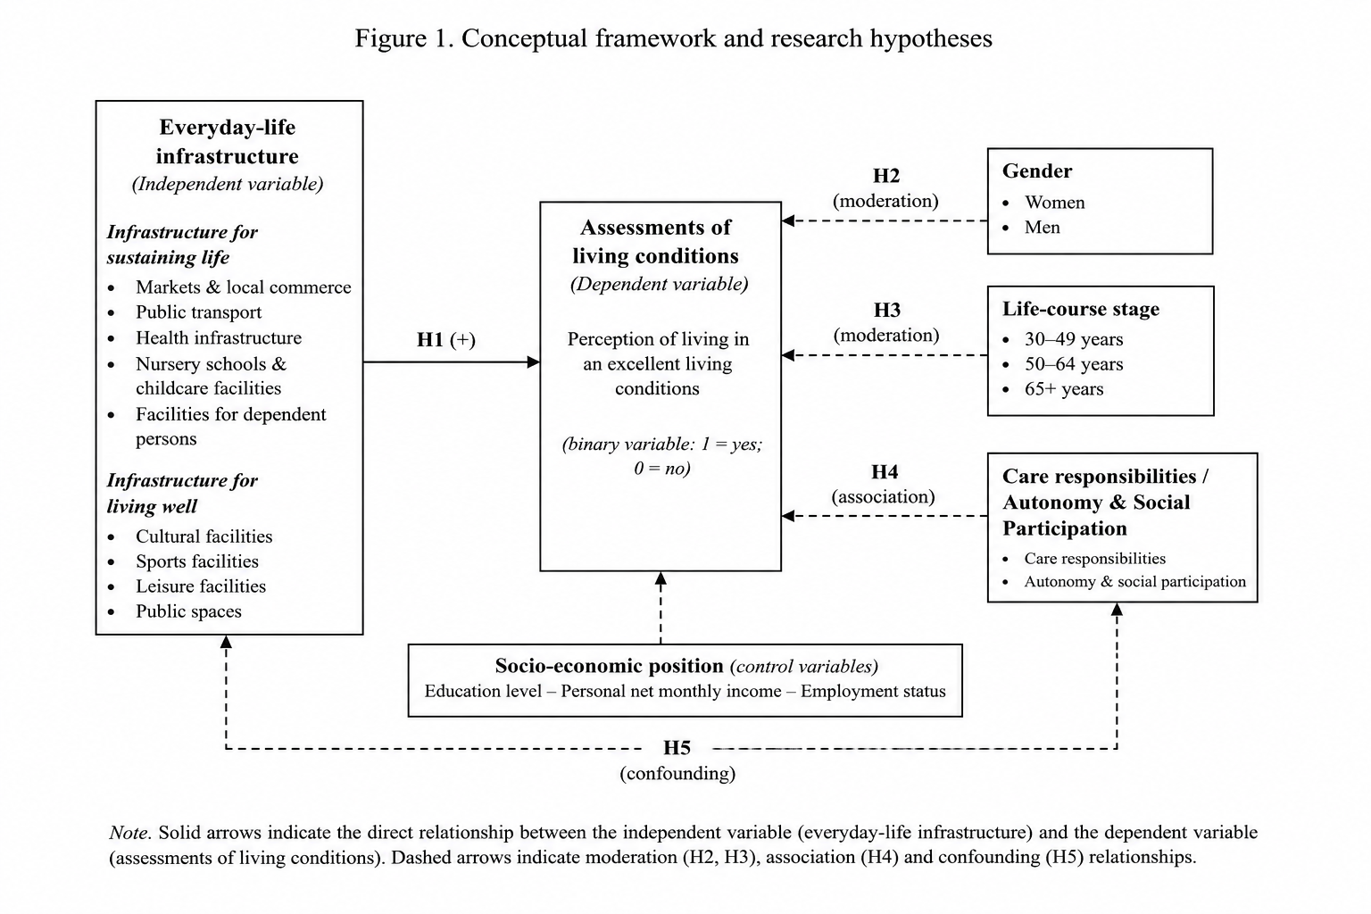
Everyday Life Infrastructure and Well-Being Across the Life Course: Evidence from Access to Care, Health, Mobility and Leisure Services
FIGURE 1. CONCEPTUAL FRAMEWORK

Slide 9
Everyday Life Infrastructure and Well-Being Across the Life Course: Evidence from Access to Care, Health, Mobility and Leisure Services
HYPOTHESES
H1. Access to everyday life infrastructure is positively associated with individuals’ assessments of their living conditions.
H2. The everyday life infrastructure associated with positive assessments of living conditions varies by gender.
H3. The everyday life infrastructure associated with positive assessments of living conditions differs across stages of the life course.
H4. During life course stages characterised by intensive care responsibilities, everyday life infrastructure that sustains daily life is expected to play a particularly salient role in shaping positive assessments of living conditions.
H5. In later life course stages, everyday life infrastructure that enables autonomy, social participation, leisure and community engagement is expected to play a particularly salient role in shaping positive assessments of living conditions.

Slide 10
Everyday Life Infrastructure and Well-Being Across the Life Course: Evidence from Access to Care, Health, Mobility and Leisure Services
METHODOLOGY
SURVEY DESIGN
National CATI survey conducted in Spain in April 2024.
Sample: 1,502 adults aged 18+.
Stratified by municipality size, gender and age group.
Sampling error: ±2.53% at 95.5% confidence level.
KEY VARIABLES
Dependent variable: “The conditions of my life are excellent”. Likert 1–10 scale.
Explanatory variables:
  Socioeconomic: education and income
  Access of everyday life infrastructure: access to childcare, healthcare, dependent care, public transport, public spaces, local commerce, cultural/sport facilities and business areas.

Slide 11
Everyday Life Infrastructure and Well-Being Across the Life Course: Evidence from Access to Care, Health, Mobility and Leisure Services
METHODOLOGY
ANALYSIS
1. Descriptive analysis by gender and age.
2. Hierarchical regressions:
Model 1 includes education and income.
Model 2 adds access of infrastructure variables. Models are estimated by gender and age group.
3. Gender- and age-specific analyses across the life course.

Slide 12
Everyday Life Infrastructure and Well-Being Across the Life Course: Evidence from Access to Care, Health, Mobility and Leisure Services
DESCRIPTIVE RESULTS: INFRASTRUCTURE ACCESS
Access Infrastructure | Total |  | Women |  | Men |  | p t-student (bilateral) | Effect size Cohen’s d
 | Mean | SD | Mean | SD | Mean | SD
Nursery Schools & childcare Facilities | 9.61 | 15.249 | 9.42 | 14.206 | 9.82 | 16.271 | .616 | -
Health centres & hospitals | 7.56 | 2.336 | 7.65 | 2.347 | 7.47 | 2.322 | .135 | -
Facilities for dependent persons | 8.88 | 17.338 | 8.76 | 16.866 | 9.00 | 17.826 | .791 | -
Pedestrian areas, parks, public lighting and green spaces | 7.66 | 2.210 | 7.75 | 2.237 | 7.57 | 2.179 | .102 | -
Markets and local commerce | 7.22 | 4.250 | 7.36 | 5.390 | 7.07 | 2.572 | .199 | -
Public transport | 6.97 | 7.368 | 7.32 | 8.676 | 6.59 | 5.680 | .055** | .38
Cultural, leisure and sports facilities | 6.98 | 4.168 | 6.96 | 4.207 | 7.01 | 4.130 | .807 | -
Industrial parks and business areas | 6.40 | 8.499 | 6.51 | 9.983 | 6.29 | 6.615 | .615 | -
Access to everyday-life infrastructure is generally rated positively.
Interpretation: access is not experienced uniformly across the population, which justifies gender-sensitive analysis.

Slide 13
Everyday Life Infrastructure and Well-Being Across the Life Course: Evidence from Access to Care, Health, Mobility and Leisure Services
DESCRIPTIVE RESULTS: LIVING CONDITIONS
Age Group | Total |  | Women |  | Men |  | p t-student (bilateral) | Effect size Cohen’s d
 | Mean | SD | Mean | SD | Mean | SD
Age 18-30 | 6.88 | 2.250 | 6.50 | 2.407 | 7.24 | 2.033 | .011*** | .28
Age 31-45 | 7.05 | 5.384 | 7.45 | 7.369 | 6.66 | 2.033 | .177 | -
Age 46-65 | 6.74 | 2.073 | 6.67 | 2.249 | 6.81 | 1.880 | .436 | -
Age 65+ | 7.87 | 5.143 | 8.02 | 6.736 | 7.69 | 1.858 | .138 | -
Total | 7.11 | 3.964 | 7.18 | 5.204 | 7.05 | 1.974 | .515 | -
Key message:
Well-being is not uniform across age groups.
Gender and life course stage interact in shaping assessments of living conditions.

Slide 14




Everyday Life Infrastructure and Well-Being Across the Life Course: Evidence from Access to Care, Health, Mobility and Leisure Services
REGRESSION RESULTS: GENDER DIFFERENCES
 | General (N= 1502) Standardized Coefficients |  | 18-30 years (N= 242) Standardized Coefficients |  | 31-45 years (N= 340) Standardized Coefficients |  | 46-65 years (N= 545) Standardized Coefficients |  | > 65 years (N= 375) Standardized Coefficients
 | Men (N= 736) | Women (N= 766) | Men (N= 123) | Women (N= 119) | Men (N= 172) | Women (N= 168) | Men (N= 272) | Women (N= 273) | Men (N= 169) | Women (N= 206)
Model 1 | R²=0.002 | R²=0.014 | R²=-0.008 | R²=0.056 | R²=0.025 | R²=0.095 | R²=0.006 | R²=0.059 | R²=0.000 | R²=0.015
Education | 0.040 | -0.017 | 0.079 | 0.226** | 0.137* | 0.050 | 0.078 | 0.162** | -0.018 | -0.120*
Income Level | -0.016 | 0.120*** | 0.049 | -0.082 | -0.087 | 0.304*** | -0.036 | 0.171** | -0.005 | 0.041
Model 2
Education | 0.036 | 0.010 | 0.069 | 0.309*** | 0.095 | 0.017 | 0.049 | 0.144** | 0.040 | 0.015
Income Level | -0.014 | 0.136*** | 0.024 | -0.152 | -0.058 | 0.280*** | -0.034 | 0.162** | -0.005 | 0.061**
Infrastructure for sustaining life
Nursery Schools & childcare Facilities | -0.002 | 0.023 | -0.049 | 0.081 | -0.128 | -0.027 | 0.049 | -0.076 | 0.096 | 0.041
Health centres & hospitals | 0.051 | -0.051 | 0.108 | 0.187* | 0.005 | 0.117 | -0.078 | 0.032 | 0.082 | -0.073**
Facilities for dependent persons | -0.005 | 0.136*** | 0.000 | -0.026 | -0.029 | 0.298*** | -0.021 | 0.142** | -0.038 | 0.022
Public transport | 0.092** | 0.003 | -0.188 | 0.073 | 0.099 | 0.060 | 0.085 | -0.039 | 0.154 | 0.005
Industrial parks and business areas | 0.037 | -0.110*** | 0.115 | -0.107 | 0.021 | -0.108 | 0.035 | -0.011 | -0.049 | -0.094**
Infrastructure for living well
Pedestrian areas, park, public lighting and green spaces | 0.186*** | -0.096** | 0.227** | 0.118 | 0.098 | -0.105 | 0.248*** | 0.066 | 0.243*** | -0.038
Markets and local commerce | 0.015 | 0.160*** | 0.006 | 0.053 | 0.092 | -0.095 | 0.010 | 0.069 | -0.173* | 0.147***
Cultural, leisure and sports facilities | 0.105** | 0.479*** | 0.125 | -0.207* | 0.174* | 0.130 | 0.185** | 0.073 | 0.121 | 0.809***
VIF max. | 1.381 | 1.946 | 2.166 | 1.782 | 1.766 | 1.699 | 1.609 | 1.806 | 2.332 | 2.334
F | 7.698*** | 43.144*** | 1.395 | 1.789* | 2.590 | 4.115*** | 4.996*** | 3.223*** | 1.831* | 92.635***
R² | 0.096*** | 0.364*** | 0.111 | 0.142* | 0.136 | 0.208*** | 0.161 | 0.110*** | 0.104 | 0.826***
Adjusted R² | 0.084*** | 0.355*** | 0.031 | 0.063 | 0.082** | 0.157*** | 0.129*** | 0.076** | 0.047 | 0.817***
Δ R² | 0.082 | 0.350 | 0.119 | 0.086 | 0.111 | 0.113 | 0.155 | 0.051 | 0.104 | 0.811

Slide 15
Everyday Life Infrastructure and Well-Being Across the Life Course: Evidence from Access to Care, Health, Mobility and Leisure Services
REGRESSION RESULTS: GENDER DIFFERENCES
OVERALL
Adding everyday life infrastructure variables substantially improves the explanatory power of the models, especially for women.
Everyday-life infrastructure is a significant determinant of well-being beyond education and income.
GENDER DIFFERENCES
MEN
WOMEN
Positive predictors:
green/pedestrian spaces
cultural, leisure and sports facilities
public transport
Positive predictors:
cultural, leisure and sports facilities
markets and local commerce
facilities for dependent persons

Slide 16
Everyday Life Infrastructure and Well-Being Across the Life Course: Evidence from Access to Care, Health, Mobility and Leisure Services
REGRESSION RESULTS:
KEY PATTERNS: LIFE COURSE DIFFERENCES
Young women (18–30): health services are especially relevant.
Women aged 31–65: facilities for dependent persons become the strongest predictor.
Older women (65+): local commerce and cultural/leisure facilities are key.
Older men (65+): green and pedestrian spaces are most relevant.
MAIN CONCLUSION
The infrastructure associated with positive living conditions differs by gender and life-course stage.

Slide 17
Everyday Life Infrastructure and Well-Being Across the Life Course: Evidence from Access to Care, Health, Mobility and Leisure Services
HYPOTHESES CONFIRMATION
Hyp. | Confirmation | Status
H1 | Infrastructure improves the explanation beyond education and income. | Confirmed
H2 | Relevant infrastructures differ by gender. | Confirmed
H3 | Relevant infrastructures vary across the life course. | Confirmed
H4 | Care-related infrastructure is especially relevant in midlife, mainly among women. | Mainly confirmed
H5 | Cultural/leisure facilities and local commerce support autonomy and participation among older women. | Strongly confirmed

Slide 18
Everyday Life Infrastructure and Well-Being Across the Life Course: Evidence from Access to Care, Health, Mobility and Leisure Services
DISCUSSION
MAIN MESSAGE
Everyday life infrastructure should be understood as a determinant of well-being, capabilities, care, autonomy and social participation.
INTERPRETATION
Infrastructure is not gender-neutral.
Women’s well-being is more closely linked to care, proximity services, local commerce and social participation.
Men’s well-being is more consistently associated with public space, mobility, leisure and green areas.

Slide 19
Everyday Life Infrastructure and Well-Being Across the Life Course: Evidence from Access to Care, Health, Mobility and Leisure Services
POLICY IMPLICATIONS
PLANNING
Infrastructure planning should include gender and life-course perspectives.
Care infrastructure must be treated as strategic public investment.
Public investment should be evaluated through well-being, capabilities, time use, accessibility, safety and participation.
BUDGETING
Gender-responsive budgeting should ask not only how much is invested, but whose capabilities are expanded by that investment.

Slide 20
Everyday Life Infrastructure and Well-Being Across the Life Course: Evidence from Access to Care, Health, Mobility and Leisure Services
CONCLUSIONS
Everyday life infrastructure shapes well-being beyond education and income.
Infrastructure is not gender-neutral: its relevance is stronger among women.
The social value of infrastructure changes across the life course.
For women in midlife, care-related infrastructure is especially relevant.
For older women, cultural, leisure, sports facilities and local commerce are key to autonomy and participation.
CORE CONTRIBUTION
A dynamic feminist understanding of infrastructure as a determinant of well-being across the life course.

Slide 21
Everyday Life Infrastructure and Well-Being Across the Life Course: Evidence from Access to Care, Health, Mobility and Leisure Services
LIMITATIONS AND FUTURE RESEARCH
LIMITATIONS
Cross-sectional data: associations, not causal effects.
One subjective well-being indicator.
Infrastructure access is based on respondents’ perceptions.
Other inequalities need deeper analysis: income, territory, disability, migration status, household composition and rural–urban location.
FUTURE RESEARCH
Longitudinal studies on infrastructure and well-being over time.
More detailed measures of care, time use and household arrangements.
Mixed-methods research to understand how people use and value infrastructure.
New indicators for public investment evaluation: accessibility, affordability, quality, safety, care support, participation and subjective well-being.

Slide 22
Everyday Life Infrastructure and Well-Being Across the Life Course:
Evidence from Access to Care, Health, Mobility and Leisure Services
Gloria Alarcón García, PhD
Inocencia Mª Martínez León, PhD
THANK YOU FOR YOUR ATTENTION

