Slide 1
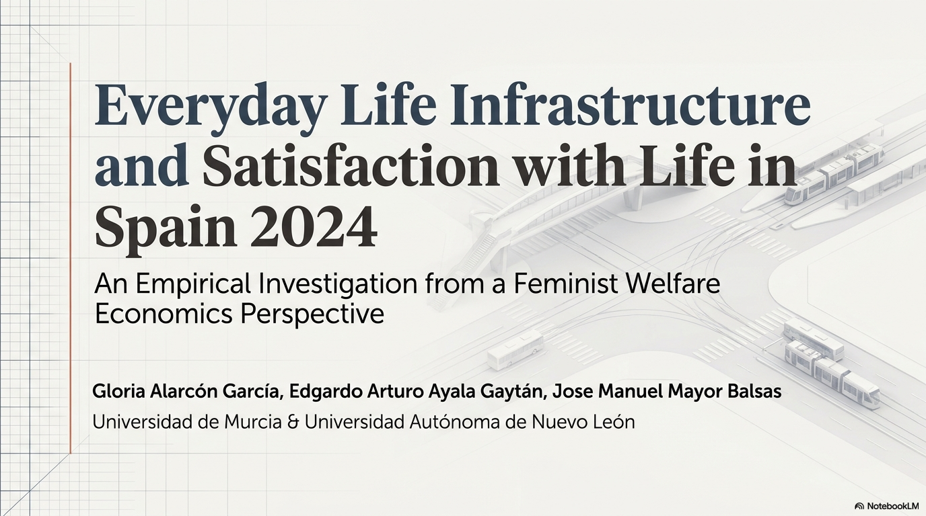

Slide 2
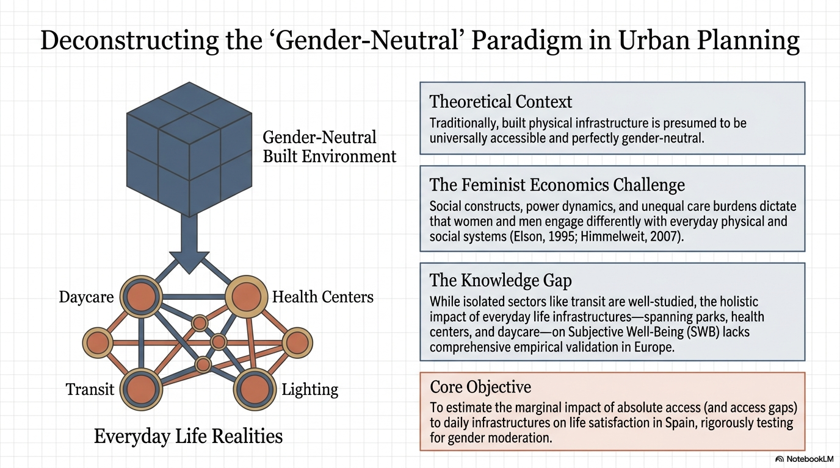

Slide 3
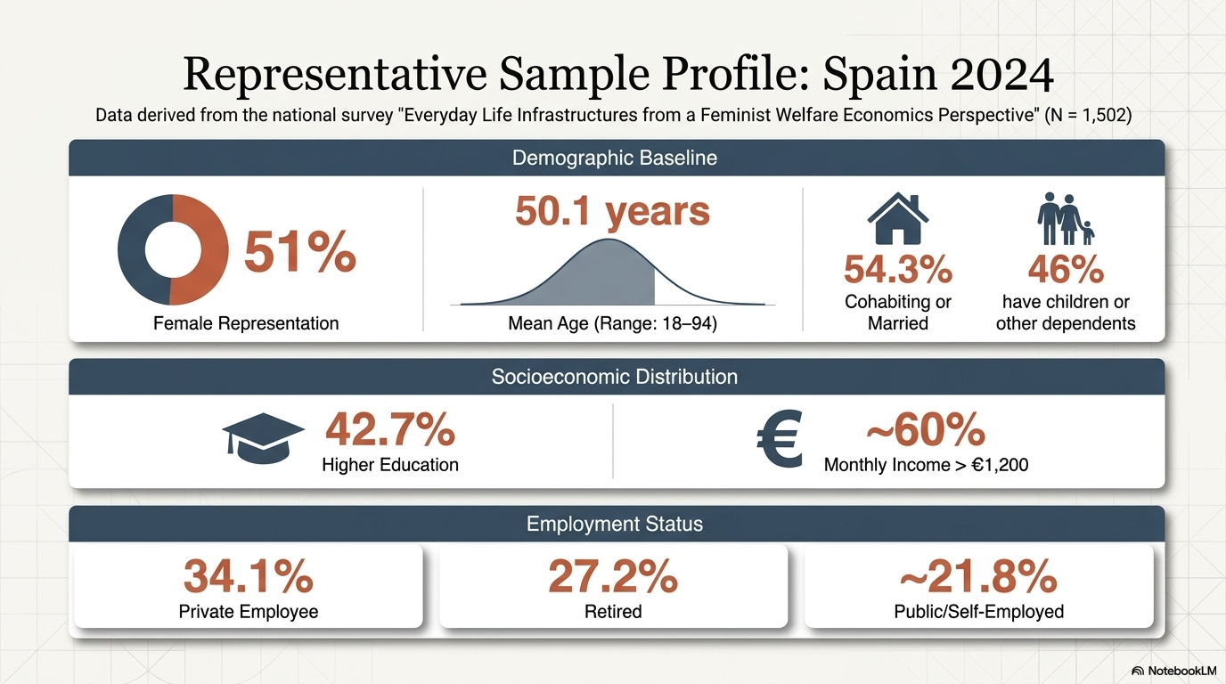
Table 1

Slide 4
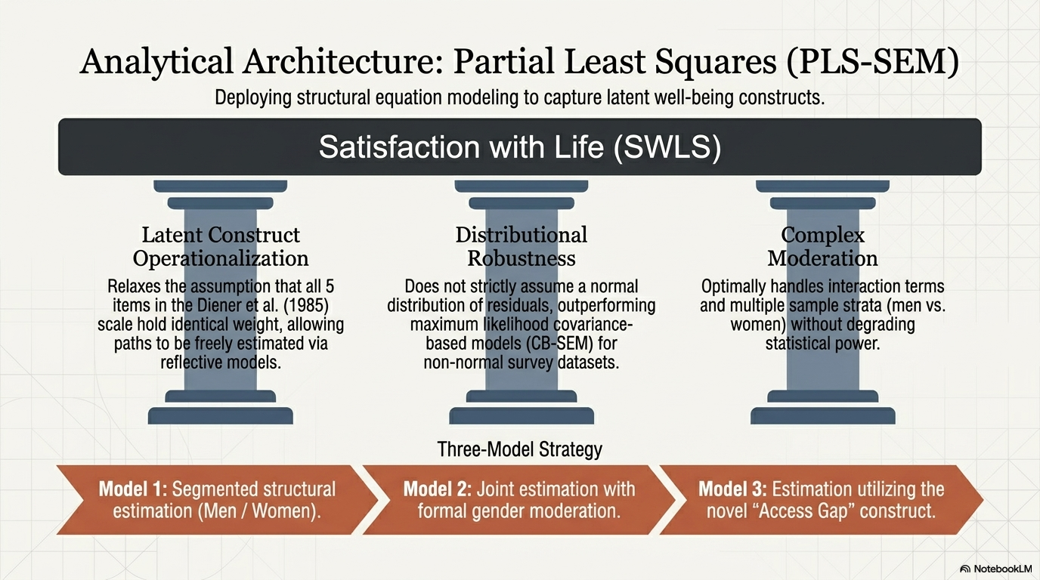

Slide 5
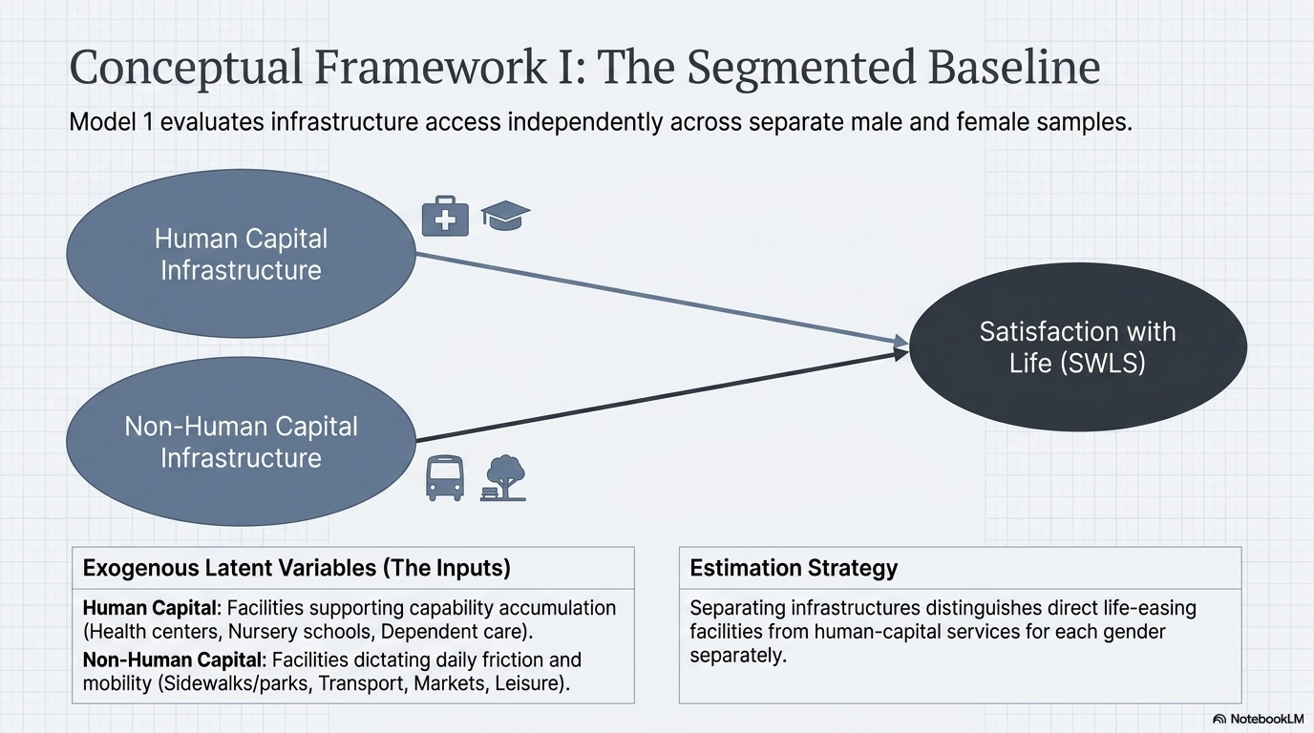
Table 2

Slide 6
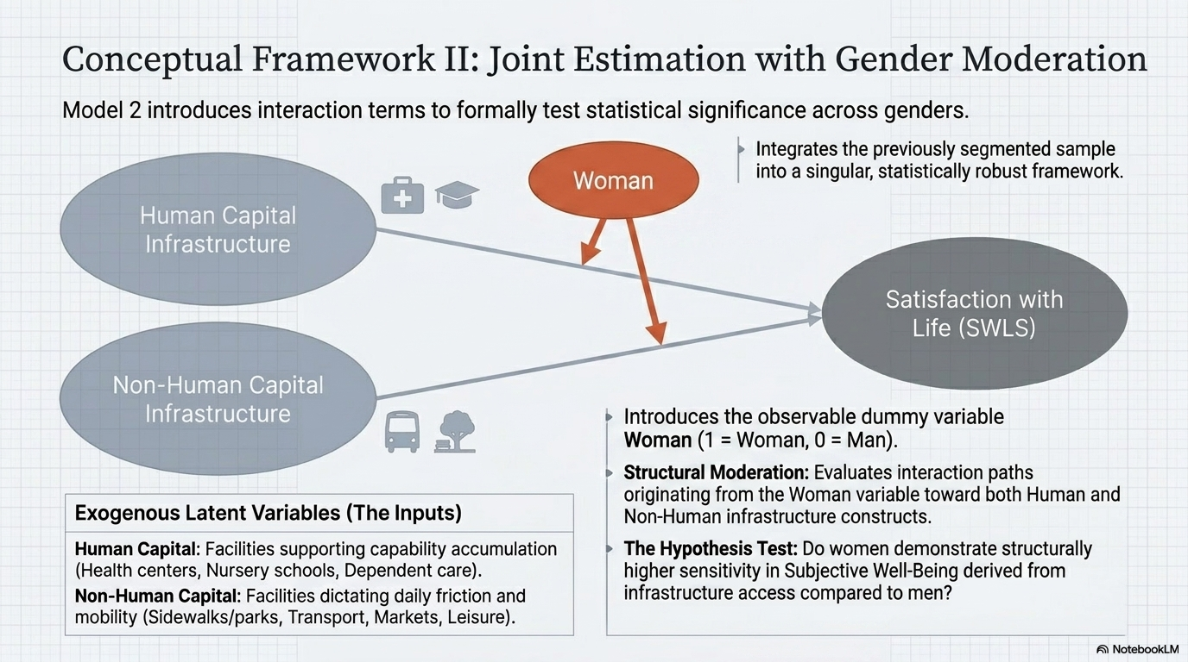
Table 3

Slide 7
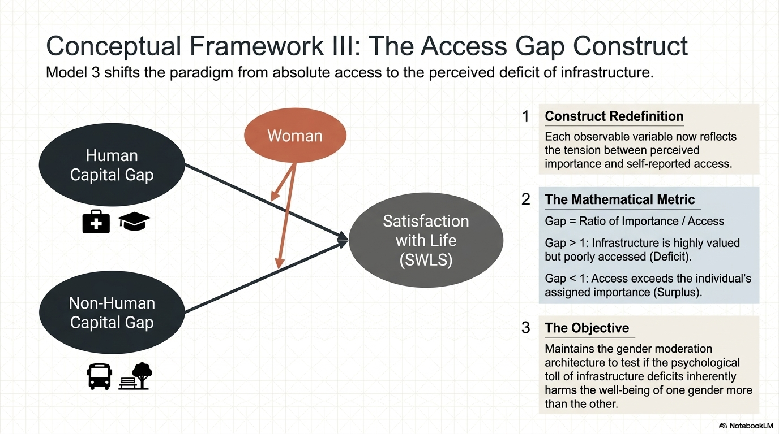
Table 4

Slide 8
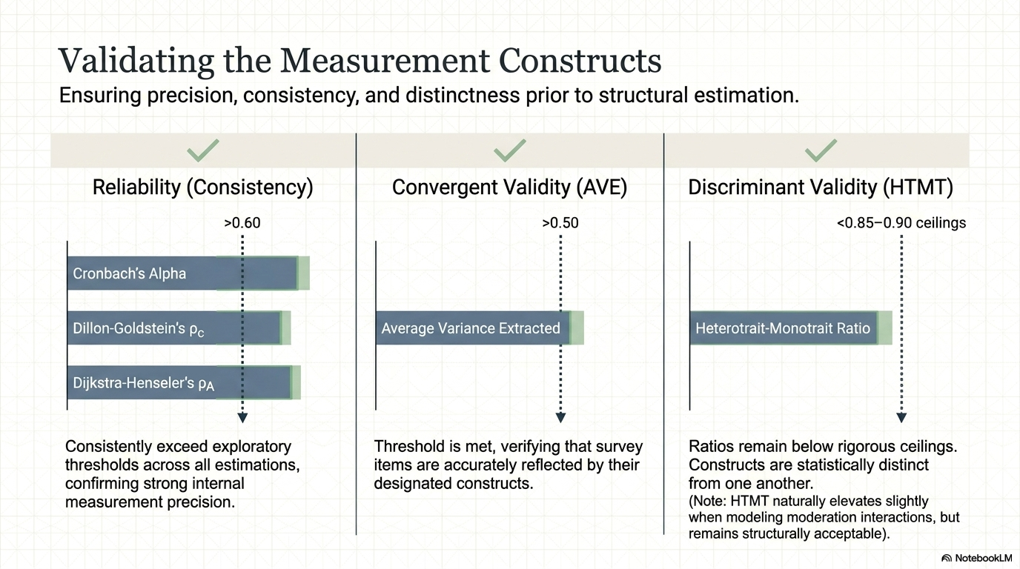
Table 5
Table 6

Slide 9
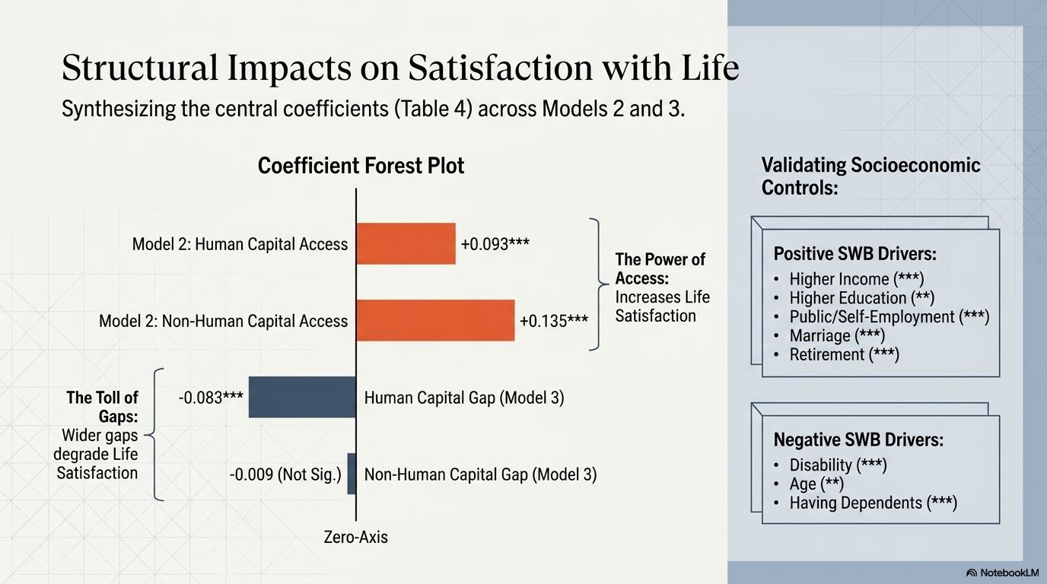
Table 7

Slide 10
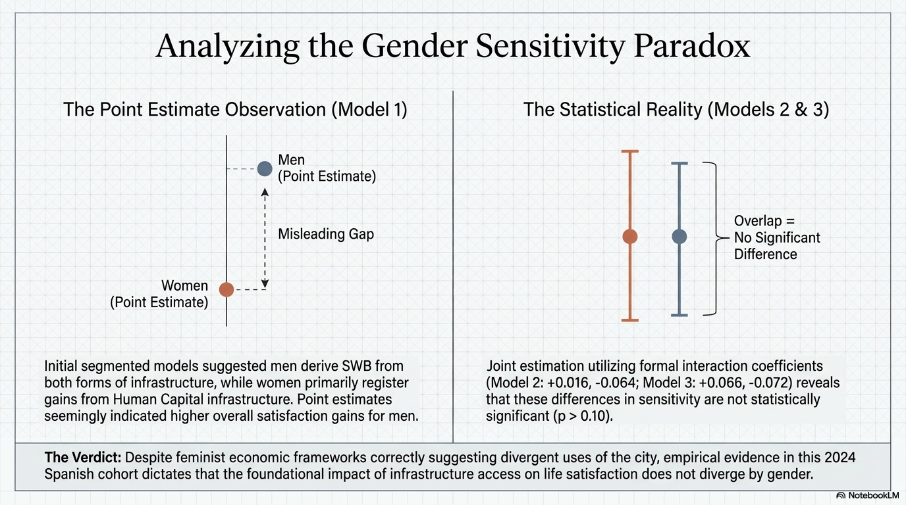

Slide 11
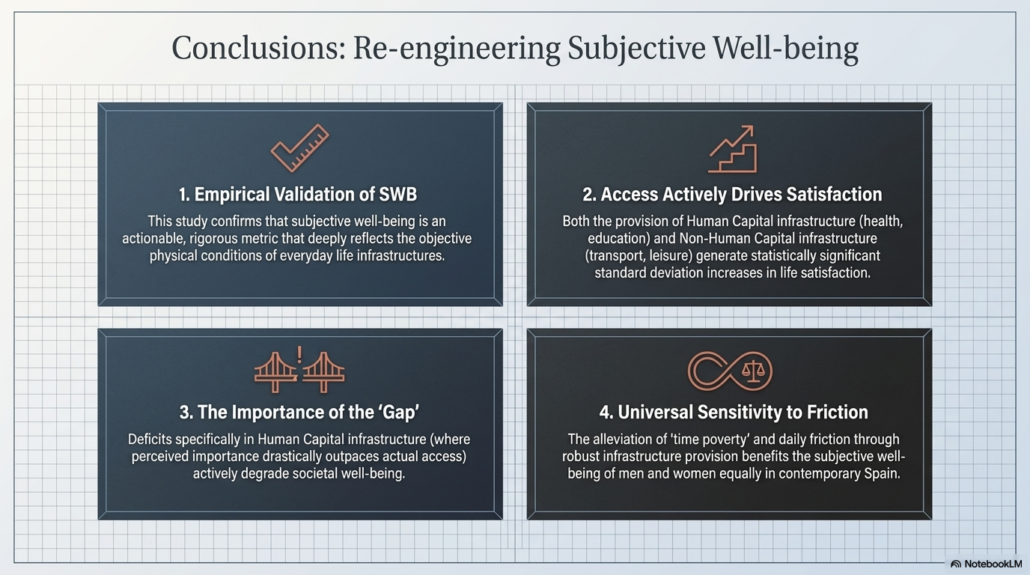

Slide 12
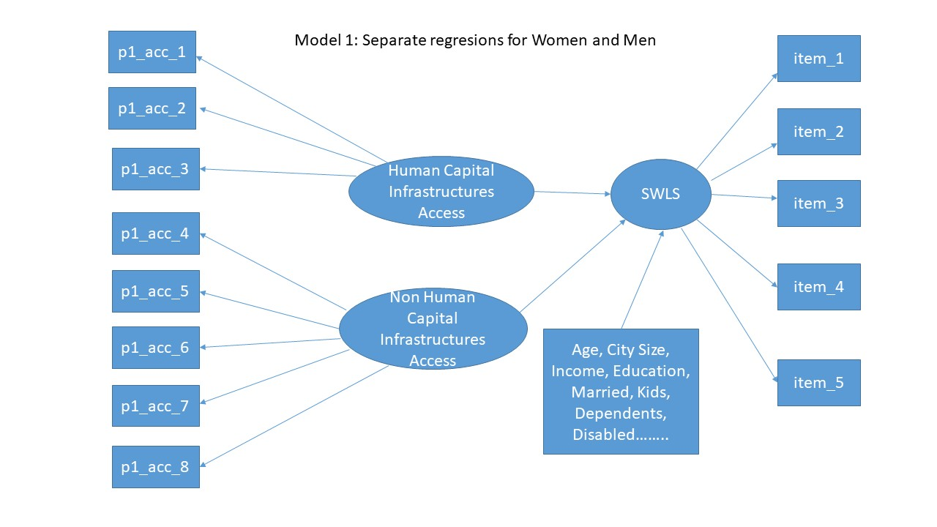
Figure 1. Path diagram of Infraestructure Gap and Satisfaction with Life Model 1
in Spain 2024

Slide 13
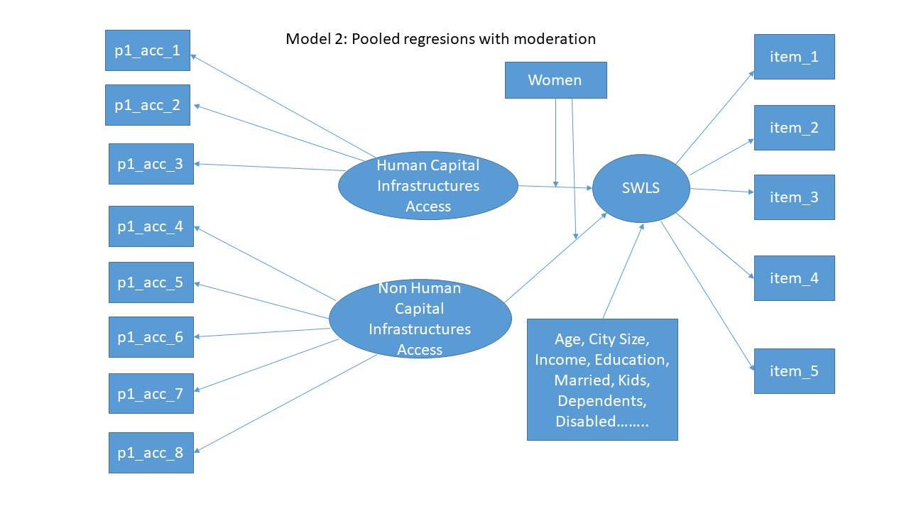
Figure 2.
Path diagram of Infrastructue Access and Satisfaction with Life Model 2 in Spain 2024

Slide 14
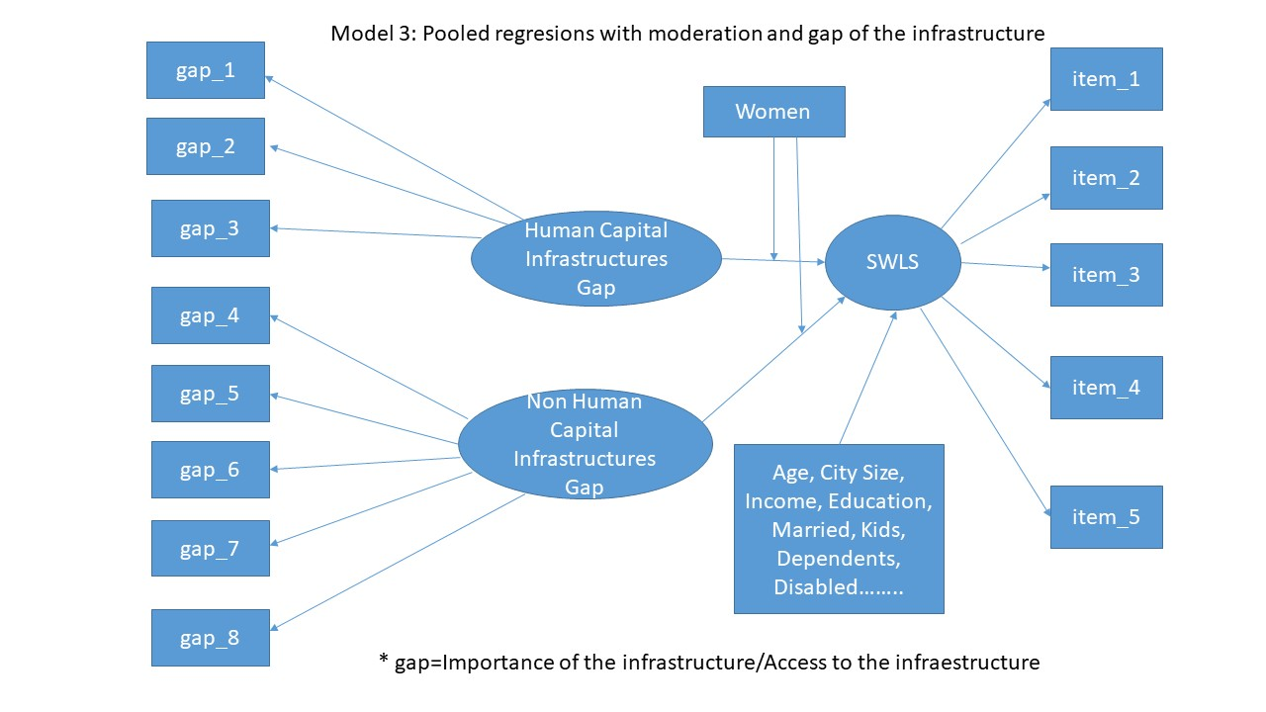
Figure 3. Path diagram of Infrastructue Gap and Satisfaction with Life Model 3
in Spain 2024

Slide 15
Table 1
Descriptive Statistics of the survey: "Everyday Life Infrastructures from a Feminist Welfare Economics Perspective"
 | Observations | Mean | Std Dev | Minimun | Maximum
Characteristics
Female | 1,502 | 0.5100 | 0.5001 | 0 | 1
Age | 1,502 | 50.1012 | 17.1045 | 18 | 94
Married or cohabiting | 1,495 | 0.5431 | 0.4983 | 0 | 1
Has children under 18 | 1,501 | 0.2865 | 0.4523 | 0 | 1
Has other dependents | 1,501 | 0.1845 | 0.3881 | 0 | 1
Religious | 1,471 | 0.6179 | 0.4861 | 0 | 1
Heterosexual | 1,457 | 0.9307 | 0.2541 | 0 | 1
Education
Secondary or less | 1,499 | 0.1755 | 0.3805 | 0 | 1
Upper Secondary | 1,499 | 0.3976 | 0.4896 | 0 | 1
Higher Education | 1,499 | 0.4270 | 0.4948 | 0 | 1
Monthly Income (euros)
0 a 1,200 | 1,356 | 0.4004 | 0.4902 | 0 | 1
1201 a 2400 | 1,356 | 0.4403 | 0.4966 | 0 | 1
More than 2401 | 1,356 | 0.1593 | 0.3661 | 0 | 1
Employment Status
Student | 1,501 | 0.0420 | 0.2006 | 0 | 1
Retired | 1,501 | 0.2725 | 0.4454 | 0 | 1
Unemployed | 1,501 | 0.0926 | 0.2900 | 0 | 1
Homemaker | 1,501 | 0.0300 | 0.1706 | 0 | 1
Private employee | 1,501 | 0.3411 | 0.4742 | 0 | 1
Public employee | 1,501 | 0.1073 | 0.3095 | 0 | 1
Self employed | 1,501 | 0.1113 | 0.3146 | 0 | 1

Slide 16
 | Human | Non Human | SWLS
Model 1: Women
Reliability Coefficients
Cronbach Alpha | 0.533 | 0.729 | 0.872
Dillon-Goldstein's rho (ρc) | 0.762 | 0.809 | 0.907
Dijkstra-Henseler's rho (ρA) | 0.535 | 0.758 | 0.884
Convegrent Validity
Average Variance Extracted (AVE) | 0.517 | 0.564 | 0.663
Discriminant Validity
Heterotrait-Monotrait (HTMT) | 0.814 | 0.814 | 0.24
Model 1:Men
Reliability Coefficients
Cronbach Alpha | 0.560 | 0.726 | 0.876
Dillon-Goldstein's rho (ρc) | 0.76 | 0.817 | 0.908
Dijkstra-Henseler's rho (ρA) | 0.623 | 0.745 | 0.9
Convegrent Validity
Average Variance Extracted (AVE) | 0.519 | 0.573 | 0.667
Discriminant Validity
Heterotrait-Monotrait (HTMT) | 0.807 | 0.807 | 0.196
Table 2
Reliability, Convergent and Disciminant Validity statistics for Model 1

Slide 17
 | Human | Non Human | SWLS
Model 3: Moderación Model
Reliability Coefficients
Cronbach Alpha | 0.548 | 0.727 | 0.873
Dillon-Goldstein's rho (ρc) | 0.765 | 0.818 | 0.908
Dijkstra-Henseler's rho (ρA) | 0.562 | 0.735 | 0.891
Convegrent Validity
Average Variance Extracted (AVE) | 0.622 | 0.675 | 0.665
Discriminant Validity
Heterotrait-Monotrait (HTMT) | 0.845 | 0.812 | 0.127
Model 4: Gap Model
Reliability Coefficients
Cronbach Alpha | 0.599 | 0.657 | 0.873
Dillon-Goldstein's rho (ρc) | 0.650 | 0.769 | 0.908
Dijkstra-Henseler's rho (ρA) | 0.682 | 0.641 | 0.887
Convegrent Validity
Average Variance Extracted (AVE) | 0.519 | 0.504 | 0.666
Discriminant Validity
Heterotrait-Monotrait (HTMT) | 0.818 | 0.818 | 0.152
Table 3
Reliability, Convergent and Disciminant Validity statistics for Model 2 & 3

Slide 18
 | Dependent Variable: Satisfaction with life
 | Model 1 |  | Model 2 | Model 3
 | Women | Men | Moderation | Gap
Human Capital Infrastructure | 0.117* | 0.097* | 0.093* | -0.083*
Non Human Capital Infrastructure | 0.067 | 0.162*** | 0.135** | -0.009
Woman |  |  | 0.027 | 0.036
Interaction Human* Women |  |  | 0.016 | 0.066
Interaction Non Human* Women |  |  | -0.064 | -0.072
Age |  | -0.165*** | -0.101** | -0.122***
Middle Income | 0.066 |  | 0.061 | 0.066
High Income | 0.049 | 0.093** | 0.1*** | 0.109***
Higher Education | 0.158*** |  | 0.084*** | 0.079**
Disabled | -0.217*** |  | -0.116*** | -0.11***
Private Employee | 0.017 | 0.289*** | 0.112** | 0.117***
Public Employee | 0.118** | 0.268*** | 0.177*** | 0.176***
Married or with partner | 0.141*** | 0.112** | 0.142*** | 0.151***
Retired | 0.206*** | 0.421*** | 0.276*** | 0.291***
Catholic | 0.063*** | 0.113*** | 0.104*** | 0.112***
Has Dependents |  |  | -0.101*** | -0.106***
Self employed |  | 0.282*** | 0.139*** | 0.131***
Living in middle size location |  | 0.077* | 0.05 | 0.056*
Madrid |  |  | 0.048 | 0.05
Observations | 396 | 468 | 863 | 860
R2 adjusted | 0.15 | 0.156 | 0.153 | 0.131
Table 4
Structural coefficients of Models 1, 2 & 3 about Satisfaction with Life explained by the Access or the Gap to the Access of Human and No Human Infrastructures in Spain 2024

