Slide 1

Infrastructure for Everyday Life,
Social Well-being and
New Metrics for Public Decision-Making
10-12 June, 2026
Human Rights in Everyday Life: A Framework to Support Wellbeing
Angela O’Hagan, Professor Emerita of Equality and Public Policy
Glasgow Caledonian University, Glasgow, Scotland

Slide 2
International Convention on Economic, Social and Cultural Rights
- International protections through this Treaty are at the core of the Infrastructure for Everyday Life project – housing, education, cultural life, poverty, business and employment etc. - - Principles within ICESCR marry well with the analytical framing of this project through considerations
- Minimum Core Obligations - the floor, or basic minimum through which provision of public services
  Adequacy
  Availability
  Accessibility
  and (culturally) appropriate levels of provision cannot fall.

Slide 3
Article 2(1)
“ to take steps, individually and through international assistance and co-operation, especially economic and technical, to the maximum of its available resources, with a view to achieving progressively the full realization of the rights recognized in the present Covenant by all appropriate means, including particularly the adoption of legislative measures.”
Two significant provisions here that should underpin public policy and legislation
Maximisation of available resources – the raising and allocation of public finance;
Progressive realisation of rights – that public policy decisions should support the realisation of rights over time, all underpinned by general principles of
Non-discrimination and non-retrogression – so no discrimination on protected grounds, no detriment, unequal treatment and no rolling back on current/existing provisions.

Slide 4

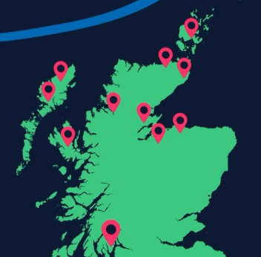
Learning from Highlands and Islands
20 communities visited
~150 people spoken to
Mixed approach: research, interviews, complaints data
Found both innovation and serious structural gaps
Rural realities not always reflected in policy design

Slide 5

Why this work matters
Human rights are about everyday life
Housing, health, education, food, work
Whether people can live with dignity
Regional and rural experiences are often under-examined
Geography shapes how rights are realised
Notes:
I’d now like to introduce you to one of the South of Scotland Monitoring Team, Dr. Alison Hosies, who will introduce the project and the issues we are looking to explore.

Slide 6
What Monitoring Means
Looking at the system as a whole
Can people realise their rights?
Are services accessible, available and of good quality?
Are things improving over time? Or getting worse?
Not about individual complaints
Not about blaming services

Slide 7

What We Mean by Economic, Social and Cultural Rights
The rights that make daily life possible
About living with dignity in the place you call home
Deeply interconnected
Housing, health, food, work, education, income, culture, water

Slide 8
What We Learned in Highlands & Islands
How geography shapes people’s experience of rights
How transport, housing, workforce and infrastructure affect access
Differences across the region
Whether some communities are consistently left behind
Rights do not operate in silos
Structural gaps alongside local innovation
Rural realities not always reflected in policy design
Housing, health access and food insecurity emerged strongly
Interconnected pressures across systems

Slide 9









Key ESC Rights

Slide 10
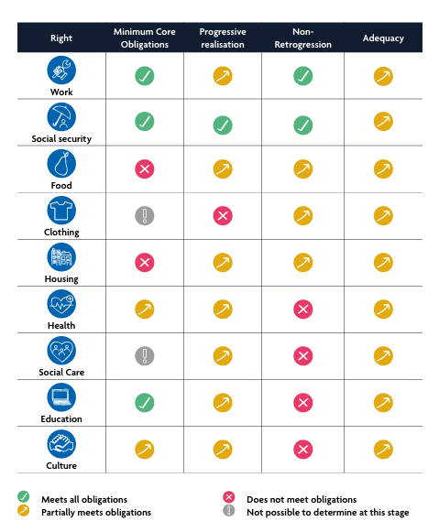

Slide 11
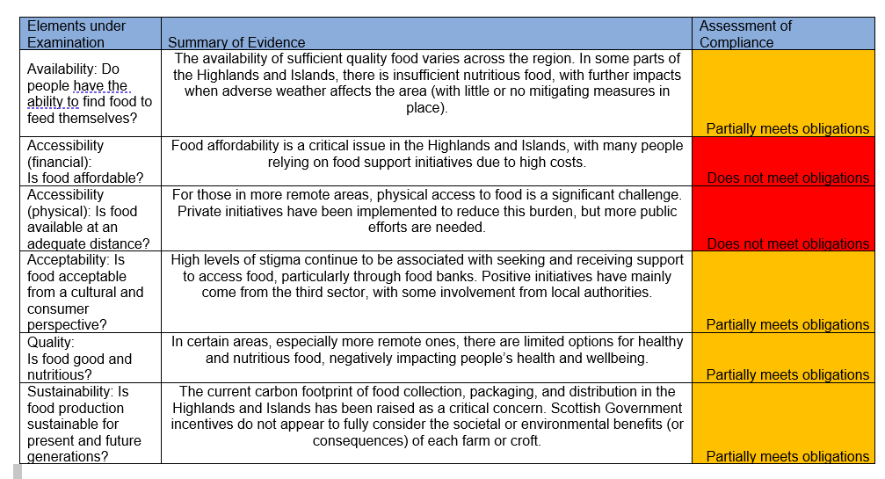

Slide 12
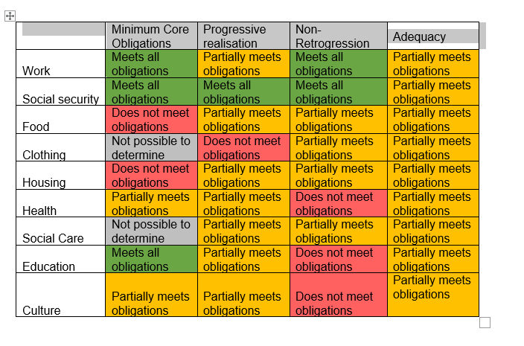

Slide 13
Housing as a Foundation
Availability and affordability challenges
Impact of short-term lets and second homes
Recruitment and workforce knock-on effects
Housing enabling or undermining other rights
Does housing where you are support or limit people’s ability to thrive?

Slide 14
Health and Access
Travel time and transport barriers
Workforce shortages and service gaps
Mental health pressures
Service design vs geographic reality
Can people realistically access the care they need?

Slide 15
Food and Everyday Adequacy
Affordability and rising costs
Distance to shops
Reliance on food banks
Dignity and normalisation of insecurity
Is access to food stable, or increasingly fragile?

Slide 16
Education and Opportunity
Transport and digital barriers
Additional support needs
Young people leaving and not returning
Education as a community anchor
Is education strengthening long-term opportunity locally?

Slide 17
Work and Local Economies
Availability of decent jobs
Seasonal or insecure employment
Skills and training access
Housing and transport constraints
Does the local economy support stable livelihoods?

Slide 18
Social Security and System Experience
Navigation and complexity
Delays and emotional impact
Dignity and respectful treatment
Interaction with other pressures
Do social security systems feel supportive or stressful?

Slide 19
Culture, Place and Identity
Community spaces and facilities
Local traditions and participation
Impact of depopulation or service loss
Cultural life as part of wellbeing
Is community life being sustained or eroded?

Slide 20
Clothing and Water – The Basics
Ability to afford weather-appropriate clothing
Water safety, reliability and infrastructure
Private supply support
Climate resilience considerations

Slide 21
CESCR – Spain 2018 Concluding Observations
Justiciability of rights
Autonomy and regional
Austerity measures –necessary, proportionate, and non-discriminatory
Maximisation of available resources
Non-discrimination
Unemployment
Gender wage gap
Trade Union Rights
Social Security
Poverty
Right to adequate housing
Migrants and Asylum seekers
Right to Health
Right to sexual and reproductive health
Right to Education
Cultural Rights

