Slide 1

Rethinking Long-Term Care Systems in Albania and Macedonia
Using GRB to improve policy response
Notes:
---

Slide 2

Rethinking Long-Term Care as Economic Infrastructure
Long-Term Care as Infrastructure
  LTC should be recognized as essential social and economic infrastructure, equal to transport and energy investments.
Current Policy Challenges
  Heavy reliance on unpaid family care shifts ageing costs to households, weakening labor participation and fiscal health.
Economic Spillover Benefits
  Investing in LTC unlocks benefits like higher employment, productivity, better health, and increased tax revenues.
Hidden Costs of Inaction
  Failing to invest in care leads to deferred costs that strain public finances and social systems.
Notes:
This presentation is based on the paper *Rethinking Long-Term Care Systems, Gender Inequality, and Fiscal Sustainability in Albania and Macedonia*. The central argument of the paper is that long-term care (LTC) should no longer be treated as a residual or marginal form of social assistance. Instead, it should be understood as essential social and economic infrastructure, comparable in importance to investments in transport, energy, or environmental services. The current policy approach in both Albania and Macedonia relies heavily on unpaid and informal family care, which shifts the economic and social costs of population ageing from the state to households. This model obscures the true costs of care, weakens labour-market participation, and undermines fiscal sustainability. By recognizing long-term care as infrastructure, governments can justify sustained public investment, including borrowing for capital expenditure, and unlock positive spillover effects across the economy. These spillovers include higher employment, improved productivity, better health and wellbeing outcomes, and increased tax and social-insurance revenues. The paper emphasizes that failing to invest in care does not mean avoiding costs; rather, it results in hidden and deferred costs that ultimately place greater strain on public finances and social systems.

Slide 3

Ageing, Low Fertility, and Emigration
Accelerating Population Ageing
  Life expectancy rises while low fertility rates cause population ageing in Albania and Macedonia.
Impact of Sustained Emigration
  Emigration of young adults reduces caregivers and formal workforce, weakening family support.
Rising Long-Term Care Needs
  Increasing older populations lead to higher demand for long-term care beyond household capacities.
Notes:
Demographic change is a central driver of rising long-term care needs in both Albania and Macedonia. Population ageing is accelerating as life expectancy increases while fertility rates remain persistently low. At the same time, sustained emigration—particularly of young and working-age adults—is reducing the number of potential caregivers within families and the formal care workforce. In Albania, the population aged 65 and over is projected to grow from around 420,000 in 2020 to more than 620,000 by 2050, with the number of older people potentially requiring long-term care expected to increase significantly by 2040. Macedonia faces an even faster ageing process, with people aged 65 and over projected to account for close to 29 percent of the population by 2042. Emigration intensifies these trends by weakening intergenerational support structures and creating geographical separation between older people and their families. As a result, care demand is rising not only because people live longer, but because traditional household-based care arrangements are increasingly unsustainable.

Slide 4
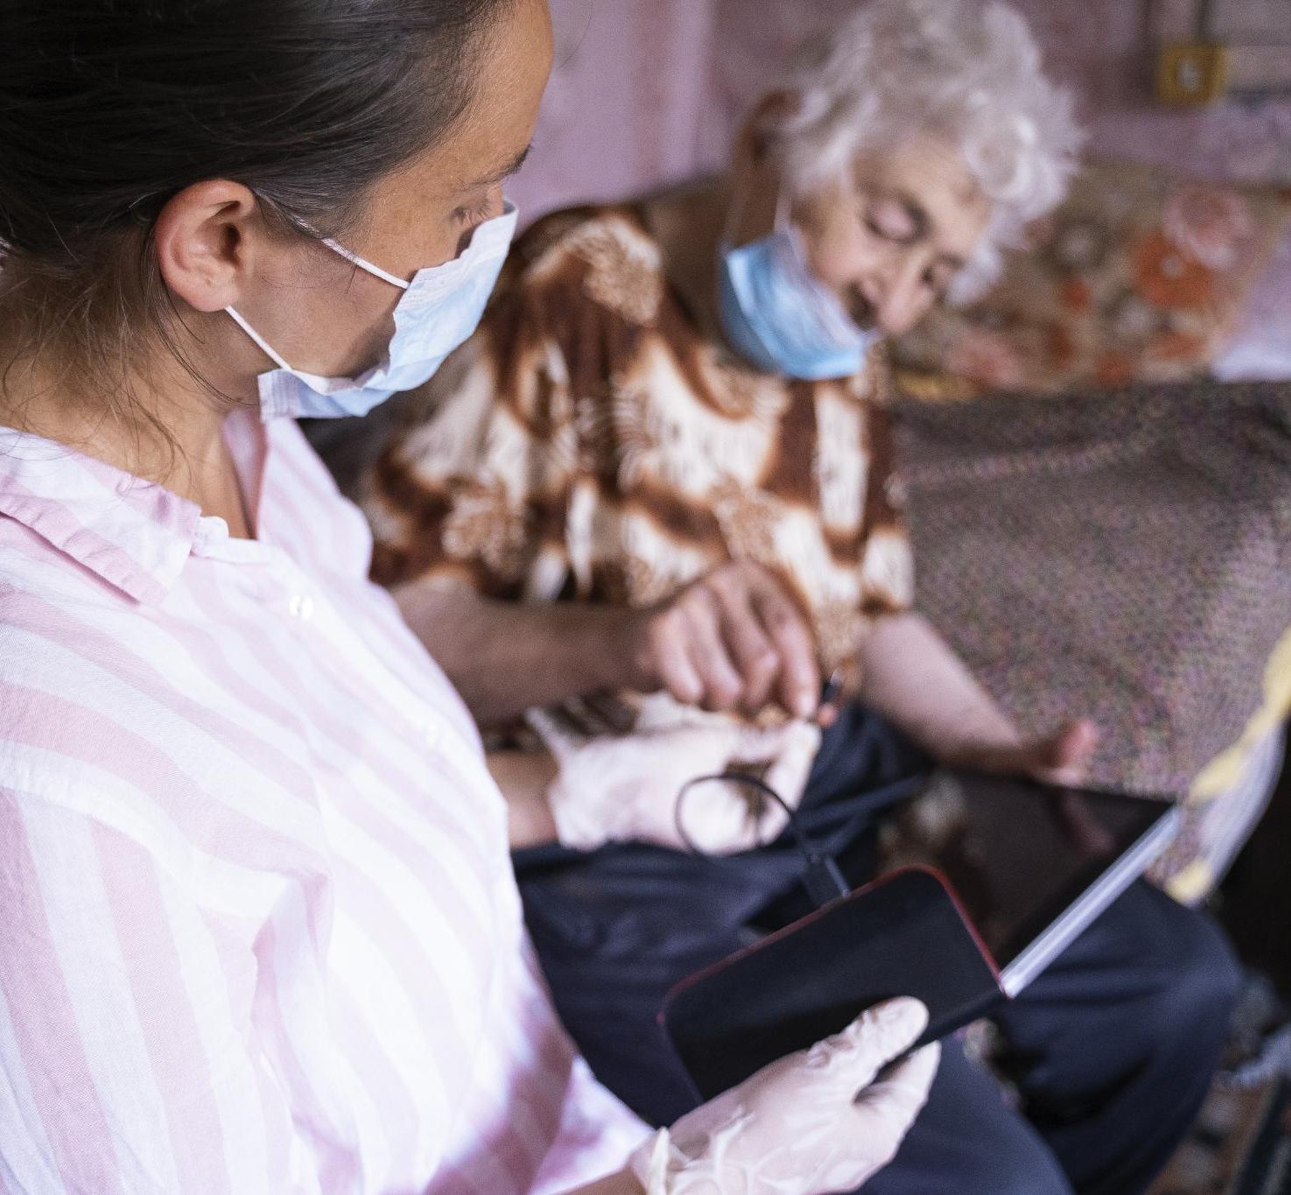
Territorial and Rural Dimensions of Care Demand
Rural Aging Populations
  Many elderly live in rural, depopulating areas far from health and social services, increasing care challenges.
Uneven Access to Care
  Urban residents have better access to formal care; rural households rely mostly on unpaid family care.
Solutions for Spatial Inequalities
  Effective LTC reform requires mobile services, community-based care, and stronger local government roles.
Notes:
The demographic pressures on long-term care are particularly acute in rural and depopulating areas. In Albania, nearly half of people aged 65 and over live in rural regions, often far from health and social services and increasingly without nearby family members due to emigration. Similar patterns are evident in Macedonia, where smaller municipalities struggle to maintain service provision as populations shrink and age. These territorial disparities mean that access to care is highly uneven, with urban residents more likely to find private or public services, while rural households depend almost entirely on unpaid family care or go without adequate support. The paper highlights that any effective long-term care reform must explicitly address these spatial inequalities through mobile services, community-based solutions, and stronger municipal capacities. Without such measures, demographic ageing will exacerbate regional inequality and social exclusion among older people.

Slide 5

Division of Responsibility Between State, Market, and Family
State Role in Long-term Care
  The state offers limited, fragmented, and institution-centered support for long-term care in Albania and Macedonia.
Market Services Accessibility
  Market-based care primarily serves households that can afford private services, limiting access for many families.
Family as Primary Caregiver
  Families provide most everyday care due to underdeveloped community services and selective formal support intervention.
Inequalities and Gender Burden
  This care model creates socio-economic inequalities and places disproportionate caregiving burdens on women within households.
Notes:
The long-term care systems in Albania and Macedonia are characterized by a highly unequal division of responsibility. The state provides limited, fragmented, and often institution-focused support, while the market primarily serves households that can afford private care. Community-based services remain underdeveloped, leaving families as the main providers of everyday care. This residual model of public responsibility means that formal services intervene only selectively, and only when family care has already failed. In Macedonia, public long-term care spending is estimated at around 0.39 percent of GDP, with the majority allocated to cash benefits rather than direct services. In Albania, public expenditure mainly covers institutional care, with very limited access to home-based or community services. This structure creates strong socio-economic and territorial inequalities and places a disproportionate burden on women within households.

Slide 6

Unpaid Care and Women’s Economic Outcomes
Gender Inequality in Unpaid Care
  Women spend significantly more time on unpaid care duties than men, reinforcing gender inequality in economic participation.
Impact on Employment and Earnings
  Unpaid care responsibilities lead women to informal, part-time, and low-paid jobs, limiting economic opportunities.
Long-term Economic Effects
  Intensive unpaid care reduces women’s pension entitlements and increases poverty risk in old age.
Notes:
Unpaid care work is a key mechanism through which long-term care systems reproduce gender inequality. In Macedonia, women spend roughly three times as much time as men on unpaid household and care activities, contributing to a female inactivity rate of around 46 percent. In Albania, women’s combined paid and unpaid working time exceeds men’s by approximately 12 hours per week, with women overrepresented in informal, part-time, and low-paid employment. As eldercare needs grow, middle-aged and older women—particularly in rural areas—are increasingly expected to provide intensive care without pay, social insurance, or formal recognition. Over the life course, this reduces earnings, weakens pension entitlements, and increases the risk of poverty in old age. Women thus experience the care system both as unpaid providers and later as older persons with inadequate income and limited access to formal care.

Slide 7

Current and Projected Fiscal Pressures
Country | Current recorded/estimated LTC cost | Demographic outlook | Approximate 2050 cost implication
Albania | Estimated cost of meeting current needs: at least 0.58% of GDP in 2020–2021 | People needing LTC increase from 90,900 to about 161,100 | About 1.0% of GDP, assuming cost per person and other conditions remain broadly constant
Macedonia | Current LTC expenditure: approximately 0.39% of GDP | Population aged 65+ rises from roughly 18% to 32% by 2050 | Around 0.7% of GDP, under a simple demographic scaling assumption
Fiscal Impact of Inadequate Care
  Lack of preventive and community care shifts costs to expensive hospitals and institutions, raising public expenditure.
Notes:
Expanding formal long-term care systems requires public investment, but the paper demonstrates that failing to invest also generates substantial fiscal costs. In Albania, estimated long-term care needs already represented at least 0.58 percent of GDP in 2020–2021, with recorded expenditure on elderly care projected to double by 2050. These pressures will coincide with pension spending of around 8 percent of GDP and rising healthcare costs linked to chronic illness and ageing. In Macedonia, long-term care spending remains low 0.39%, but stimulates care provided by family members through cash transfers. Without preventive and community-based care, manageable social-care needs are shifted into more expensive hospital and institutional services, increasing overall public expenditure.

Slide 8

Gender budgeting as a response
Budget category | Fiscal rule
Consumption (current expenditures) | No borrowing
Capital expenditures (investments) | Borrowing
Investment in social infrastructure produces spillover effects
Notes:
When we do gender budgeting we analyse two type of costs: Consumption (current expenditure) and capital expenditure (investment). Fiscal rules allow borrowing for investment not for day spending. So far these investments were primarily been used for roads, irrigation, energy, waste management and rarely for social infrastructure. Investment in social infrastructure produces spillover effects on economy, increases its competitiveness, better educational results, enhanced earnings, productivity and etc. The investment in social infrastructure incentives private investment by lowering costs across the whole economy. There are many studies that assess the investment in social infrastructure on employment creation, revenue creation and productivity gains.

Slide 9

Hidden Fiscal Costs of Unpaid Care
Lost Government Revenues
  Unpaid care reduces labor participation, causing governments to lose income-tax and social insurance contributions.
Increased Social Spending
  Caregiver poverty and inadequate support increase demand for social benefits and crisis interventions.
Investment vs Long-Term Costs
  Investing in care infrastructure prevents long-term fiscal burdens from lower employment and social exclusion.
Notes:
The reliance on unpaid care generates hidden fiscal costs that are often overlooked in policy debates. When women withdraw from the labour market or reduce working hours to provide care, governments lose income-tax revenue and social-insurance contributions. This erosion of the contribution base occurs precisely when ageing societies require higher revenues to finance pensions, healthcare, and social protection. In addition, caregiver poverty and inadequate support for dependent older people can increase demand for means-tested benefits and crisis interventions. The paper emphasizes that the relevant fiscal comparison is not between spending on care and spending nothing, but between planned investment in care infrastructure and the combined long-term costs of lower employment, lost revenues, preventable hospitalizations, and social exclusion.

Slide 10

Building Integrated and Community-Based Care Systems
Integrated Care Networks
  Shift from fragmented services to integrated home-based and municipal community care networks for effective long-term care.
Albania’s Rural Care Priorities
  Focus on rural municipalities using mobile care teams, multifunctional centres, and digital health support to improve access.
Macedonia’s Reform Focus
  Reduce cash transfers, enhance health-social care coordination, and expand municipal home-care coverage for equity.
Quality Standards and Financing
  Implement clear quality standards and sustainable financing to ensure care system equity and effectiveness.
Notes:
The paper argues that the strongest reform option for Albania and Macedonia is to treat long-term care as social and economic infrastructure. This requires a shift away from fragmented institutional provision and cash benefits toward integrated networks of home-based care, municipal community services, day centres, respite care, and coordinated health and social-care assessments. In Albania, priority should be given to rural and depopulating municipalities through mobile care teams, multifunctional community centres, and digital health support. In Macedonia, reforms should reduce the dominance of cash transfers, improve coordination between health and social systems, and expand municipal home-care coverage. Clear quality standards and sustainable financing mechanisms are essential to ensure equity and effectiveness.

Slide 11

Professionalising Care Work and Supporting Caregivers
Professionalisation of Care Work
  Accredited training and fair wages formalize care work and address labour shortages in the sector.
Supportive Working Conditions
  Flexible yet secure working arrangements and caregiver leave protect workers’ rights and wellbeing.
Economic Security Measures
  Pension credits for unpaid care and gender-responsive budgeting safeguard women’s economic security.
Promoting Gender Equality
  Valuing care work improves service quality and fosters gender equality in labour markets and social protection.
Notes:
Care-system reform must be closely linked to the professionalisation of care work. This includes accredited training, adequate wages, and full social-insurance coverage for care workers, creating formal employment opportunities while addressing labour shortages. Complementary measures such as caregiver leave, flexible but secure working arrangements, pension credits for periods of intensive unpaid care, and gender-responsive budgeting can help redistribute care responsibilities and protect women’s economic security. By valuing care work as skilled and essential labour, governments can improve service quality, promote gender equality, and strengthen the overall resilience of labour markets and social protection systems.

Slide 12

The Triple Dividend of Long-Term Care Investment
Improving Quality of Life
  Investing in accessible, professional, and community-based care enhances dignity, autonomy, and wellbeing of older adults.
Advancing Gender Equality
  Long-term care reduces unpaid care burdens on women, promoting higher workforce participation and improved earnings.
Strengthening Fiscal Sustainability
  Expanding care broadens tax bases, lowers healthcare costs, and protects caregivers and older adults from poverty.
Notes:
A key contribution of the paper is the concept of a “triple dividend” from investing in long-term care systems. First, expanding accessible, professional, and community-based care improves the dignity, autonomy, and quality of life of older people who require support with daily activities, chronic illness, or disability. Second, it advances gender equality by reducing women’s disproportionate burden of unpaid care work, enabling higher female labour-force participation, more stable careers, and improved lifetime earnings. Third, it strengthens fiscal sustainability by broadening the tax and contribution base, reducing avoidable healthcare costs, and preventing poverty among caregivers and older people. These three dimensions are deeply interconnected: social outcomes affect labour markets, labour markets affect public revenues, and public revenues determine the long-term viability of social protection systems. The paper argues that viewing long-term care through this integrated lens allows policymakers to move beyond short-term budget constraints and toward a more strategic, investment-oriented approach to ageing societies.

Slide 13


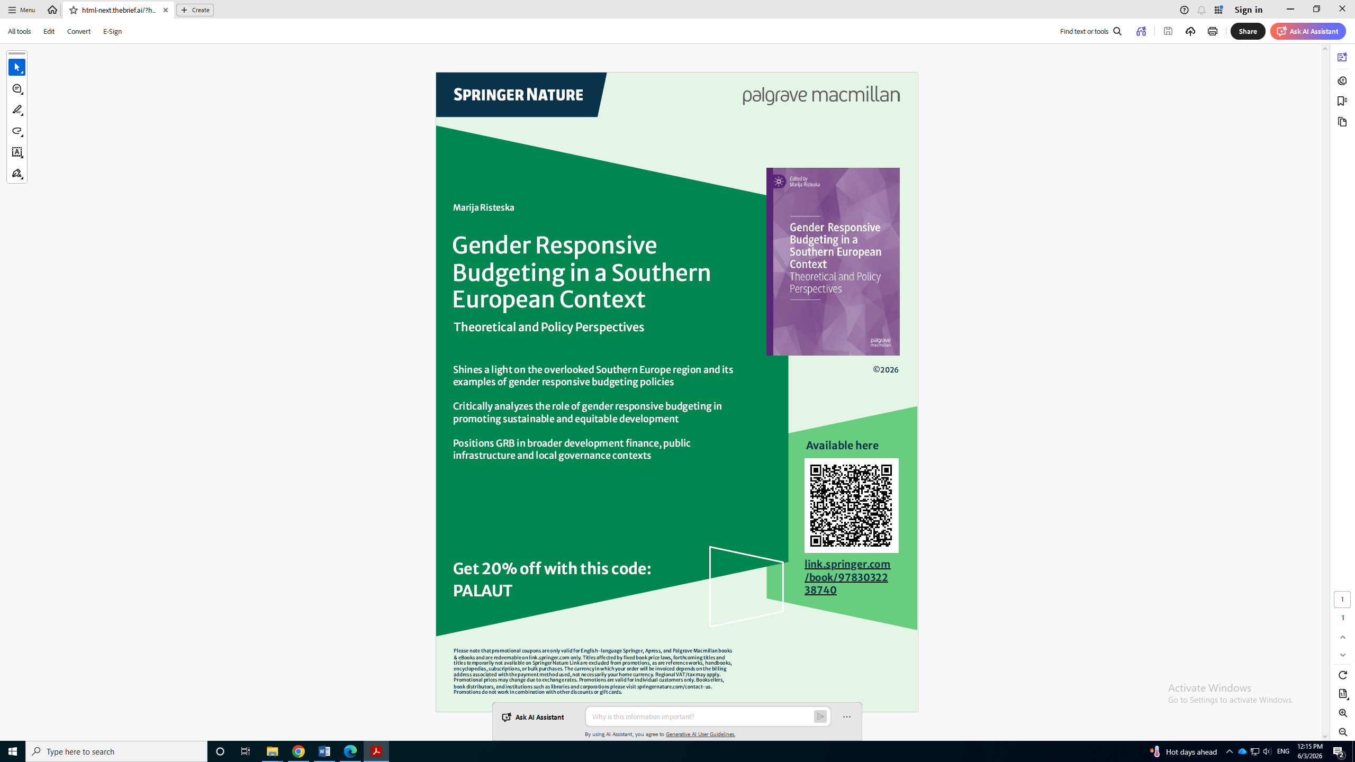
Dr. Marija Risteska
CRPM
Risteska@crpm.org.mk

