Slide 1
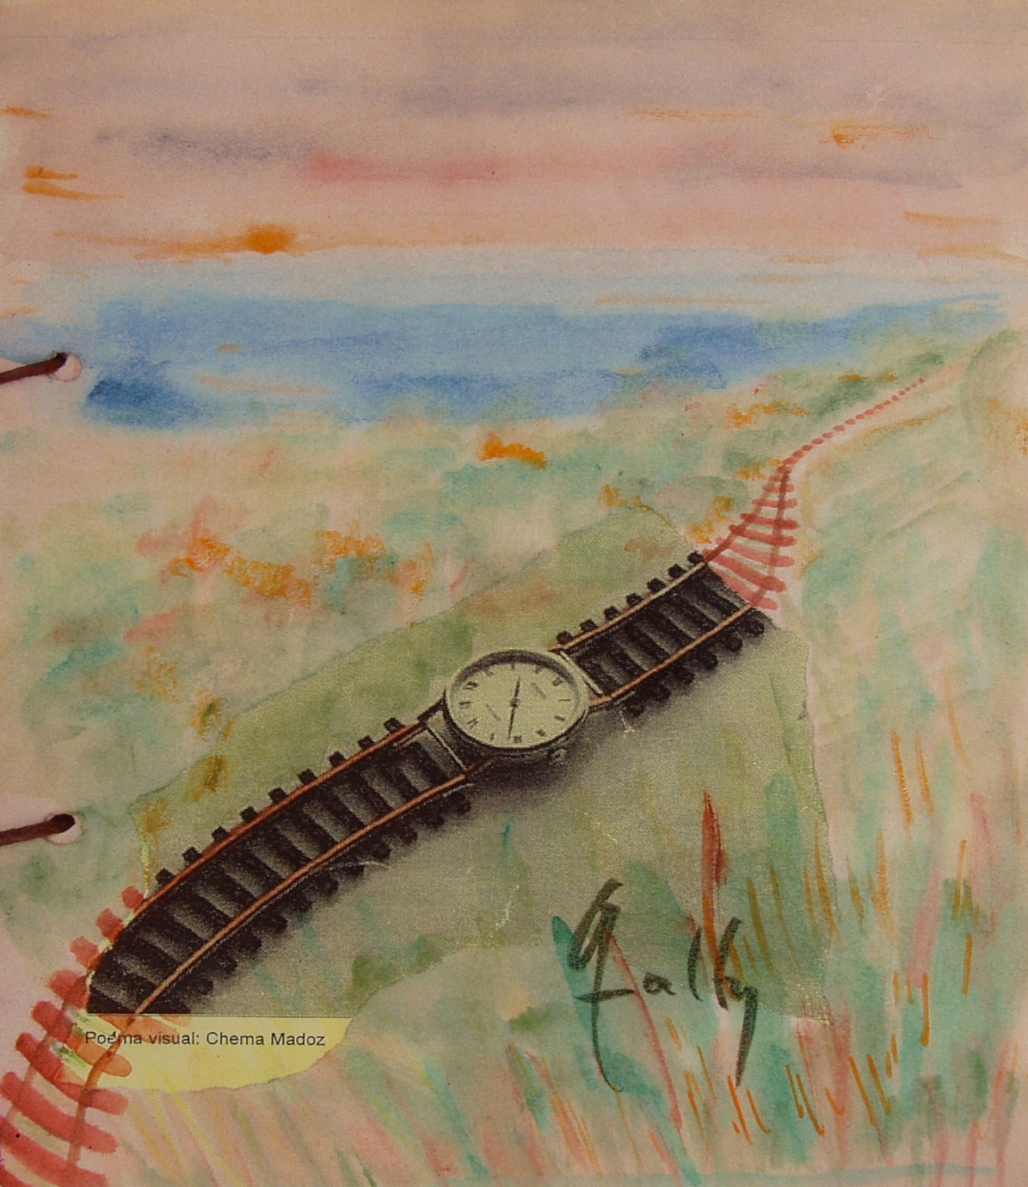
The times of care.
A qualitative perspective
Cristina García Sainz
Professor of Sociology, UAM
Sociology of Time Committee, FES
1st International Symposium “Infrastructures for everyday life, social well-being and new metrics for public decision-making.”
University of Murcia, 12 June 2026

Slide 2
The times of care. A qualitative perspective
Outline:
    Introduction: work and time
      Work from a gender perspective
      Dimensions of time
    Duration and distribution: quantitative aspects (how much and when)
    The qualitative view of chronos
    The times of care: a kairos perspective (how)
      Kairos in infrastructures: park time
      Notes for building the WIGI

Slide 3
    Introduction: work and time
Work from a gender perspective
Work is not only formal, paid employment. It also includes informal (undeclared) employment, subsistence work, voluntary work, and domestic and care work (Benería, 2005).
For analytical purposes, we simplify these dimensions into two main categories: paid work (PW) and unpaid work (UW) (Durán, 2012).
A gender perspective on work requires considering both types of activity — employment and care — and attending to the total workload (PW+UW).

Slide 4
    Introduction: work and time
Work from a gender perspective
Care work
More generally, we suggest that “caring” should be considered a generic activity encompassing everything we do to maintain, continue and repair our “world”, so that we may live in it as well as possible.
That world includes our bodies, ourselves and our environment, all of which we seek to interweave in a complex, life-sustaining web. (Fisher and Tronto, 1990, p. 40).

Slide 5

Market economy: time counts; it has market value.
Paid work
Employment
Work from a gender perspective
Unpaid work: domestic…
Non-market economy: the value of time does not count, nor do the activities.
the iceberg metaphor

Slide 6
    Introduction: work and time
Temporal dimensions of work
Origins of the representation of time: Greek mythology: Aion (fullness, life without death, eternity); Chronos (sequence, interval, number, measurement; clock and calendar time); and Kairos (occasion, opportunity, the opportune moment, a time and a place; the time of events and of relations with others).
Temporal dimensions: duration (how much), distribution (when), context and relation with others (how), and who (Heidegger, 1924).
Employment time and care time are articulated in everyday life, although they follow different temporal logics:
  the world of work and our daily rhythms follow the logic of chronos: productive time (quantitative, market-oriented): working days, schedules, haste…
  care work is oriented toward the temporal perspective of kairos (qualitative): unpredictable moments, processes, “caring about” and “caring for”.

Slide 7
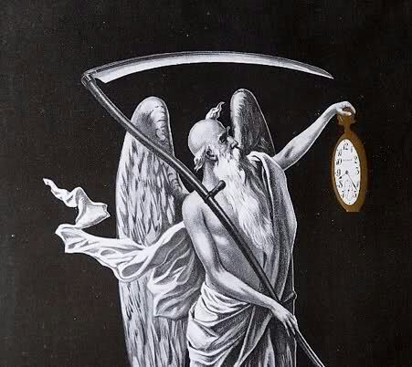
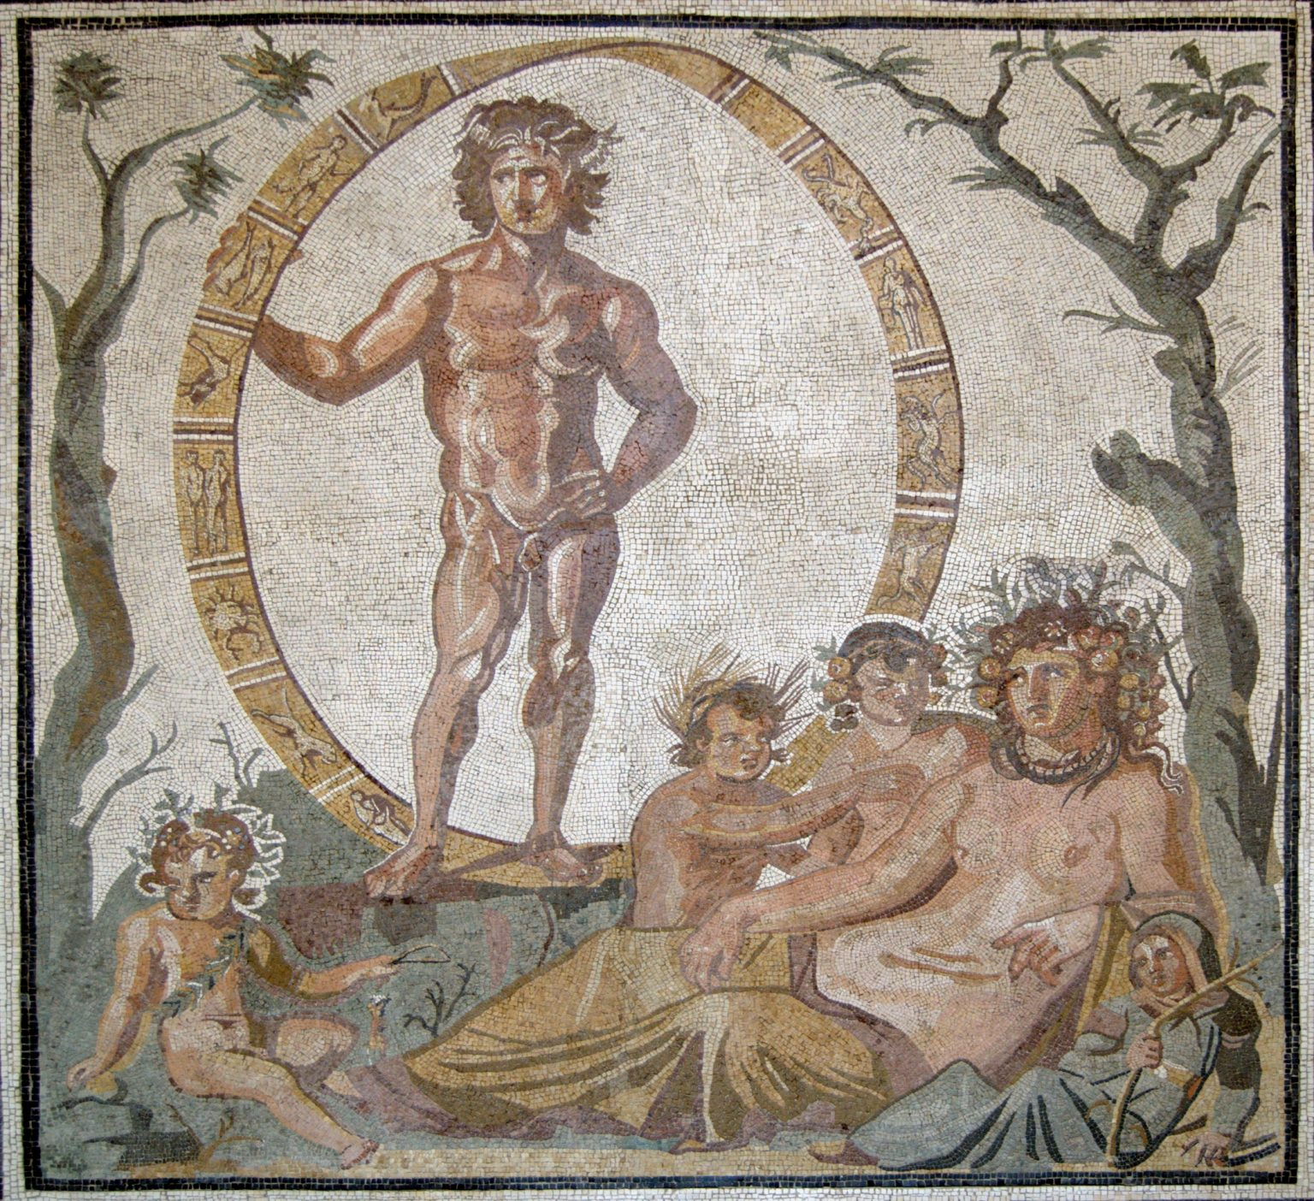
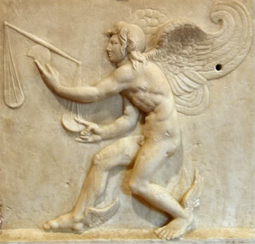
Time in Greek mythology
Chronos
Kairos
Aion

Slide 8
    Work duration: a quantitative view (chronos)
Duration (how much): the working day
Time worked:
  Time worked per week (usual hours): full-time and
  part-time work
  Long hours in main job
  People with more than one job
  Low work intensity

Slide 9
    Work duration: a quantitative view (chronos)
Indicators of employment-time duration
 | Men | Women
Hours worked full-time (week) (2023) | 41,2 | 39,3
People with a second job (2025) (Eurostat, % of total employment, both sexes; % employed women: 46.6) | 48,7 | 51,3
Living in households with low work intensity (2025) (below 20% of work potential; INE, Living Conditions Survey) | 7,5 | 8,4
Part-time work (2025) (% of total employment for each sex) | 6,9 | 21,4
In paid work (employment), men have longer working hours than women. The most notable feature among women is not excessive hours but short working hours: part-time work and insufficient hours.

Slide 10
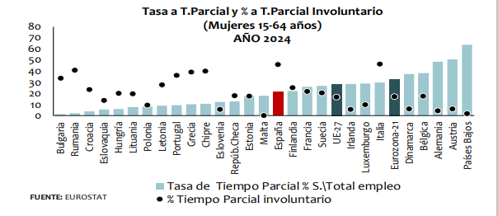
    Work duration: a quantitative view (chronos)
Part-time work and involuntary part-time work. Women. EU countries. 2024
Part-time rate and involuntary part-time %
(Women aged 15–64)
2024
Part-time rate and involuntary part-time %
(Women aged 15–64)
2024
Part-time rate, % of total employment
Part-time rate, % of total employment
% involuntary part-time
SOURCE: EUROSTAT
SOURCE: EUROSTAT
% involuntary part-time
In: Ministry of Labour and Social Economy, The situation of women in the labour market 2025

Slide 11
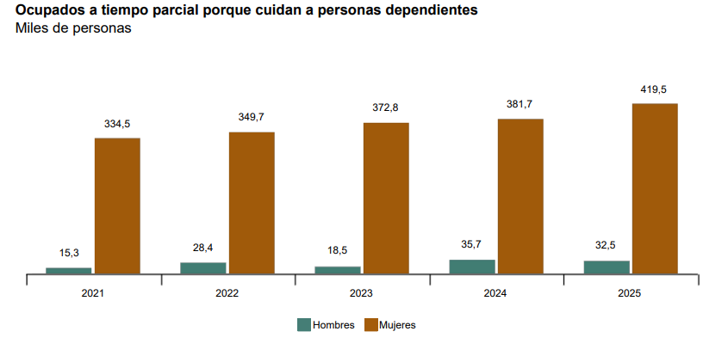
    Work duration: a quantitative view (chronos)
Part-time workers caring for dependent persons
Thousands of people
Men Women
Men
Women
Source: INE, Labour Force Survey, 2025

Slide 12
    Work duration: a quantitative view (chronos)
Domestic working day
Time worked:
  Time devoted to unpaid work (“Household and family”, INE) and paid work
  Participation in domestic and care activities (by gender)
  Time devoted to unpaid work
  Total workload

Slide 13
TIME SPENT ON UNPAID AND PAID WORK (MINUTES/DAY) AND THE GENDER GAP IN SELECTED WESTERN COUNTRIES
 | Unpaid work |  |  | Paid work
 | Women | Men | Gap | Women | Men | Gap
Austria | 269 | 146 | 123 | 160 | 264 | -104
Ecuador | 273 | 78 | 195 | 150 | 306 | -156
Spain | 263 | 126 | 137 | 128 | 205 | -77
USA | 252 | 163 | 89 | 166 | 252 | -86
Finland | 211 | 139 | 72 | 162 | 202 | -40
France | 234 | 148 | 86 | 126 | 199 | -73
Greece | 277 | 107 | 170 | 78 | 152 | -74
Italia | 305 | 108 | 197 | 103 | 223 | -120
Japan | 254 | 77 | 177 | 165 | 330 | -165
Mexico | 442 | 155 | 287 | 172 | 381 | -209
Norway | 230 | 180 | 50 | 181 | 250 | -69
Peru | 339 | 136 | 203 | 183 | 361 | -178
Romania | 264 | 125 | 139 | 100 | 163 | -63
Sweden | 240 | 194 | 46 | 201 | 245 | -44
Note: Surveys conducted in 2009–2018 (Austria, 2008–2009; Ecuador, 2012; Spain, 2009–2010; USA, 2013; Finland, 2009; France, 2010; Greece, 2013–2014; Italy, 2008–2009; Mexico, 2009; Norway, 2010; Peru, 2010; Romania, 2011–2012; Sweden, 2010–2011).
Source: UN, Human Development Report, 2015, and own elaboration.

Slide 14
Daily time devoted to household chores. Spain, 2023
Source: own elaboration based on CIS (2023), Study 3428

Slide 15
Daily time devoted to unpaid work by household type. Spain
Source: own elaboration based on INE, Time Use Survey, 2009–2010

Slide 16
    Work duration: a qualitative view of chronos
Paid work + domestic and care work. A qualitative view of “how much”.
Men devote more time to employment, with longer working hours, while women devote more time to unpaid work. (Sexual division of labour, breadwinner model; perception of productive time and economic value: “time is money”.)
Compared with standard working hours, women hold jobs with short hours: insufficient hours and involuntary part-time work (PTW). This time commitment is shaped by the demands and needs of others.
In both types of work, the temporal norm is heteronomous, marked by a lack of autonomy in deciding how much time is allocated to work.
When both types of work are combined, time poverty is commonly perceived. This is also the case when holding more than one job: urgency, precariousness and lack of free time.
Time poverty does not result only from heavy dedication to employment and family care work; it is also the perception of lacking command and control over one’s own time.

Slide 17
    Work duration: a qualitative view of chronos
Paid work + domestic and care work. A qualitative view of “when”.
A shorter working day (voluntary — work-life balance — shorter hours, reduced working time, leave, PTW), weekend work, shift work, etc., may have perverse effects for women insofar as it leaves them more time for other responsibilities — domestic or care — (doing gender), which can increase the total workload.
Time transfers occur between employment and domestic and care work, and vice versa (as in reduced working hours for care reasons), between contracted time and committed time. Reducing working hours does not imply “freed-up time” or more free time.
The distribution of working time (employment and domestic work) reflects greater “porosity”, simultaneity and continuity between both types of work among women, while among men time is distributed in successive sequences.
Time poverty economic poverty: devoting less time to employment has negative economic and social effects: wage gap, pension gap, access to social benefits (e.g. unemployment).

Slide 18
    The times of care: a kairos perspective (how)
Kairos time
Kairos is the time of opportunity; the opportune moment; the propitious time; the occasion; “everything in its own time” (typical of care); a time that has its own measure, because it is constructed in relation to others.
Kairos combines two meanings (Marramao, 2018):
  To temper, to moderate, temperament (people’s way of being, character and condition).
  Temperature (derived from atmospheric conditions, heat and cold, expressed in degrees).
Kairos represents the meeting point between these two apparently separate dimensions: the “time of life” and the “time of the world”; that is, between the time we live (subjective) and the time of nature (physical), or between one’s own time (qualitative) and clock time (quantitative).

Slide 19
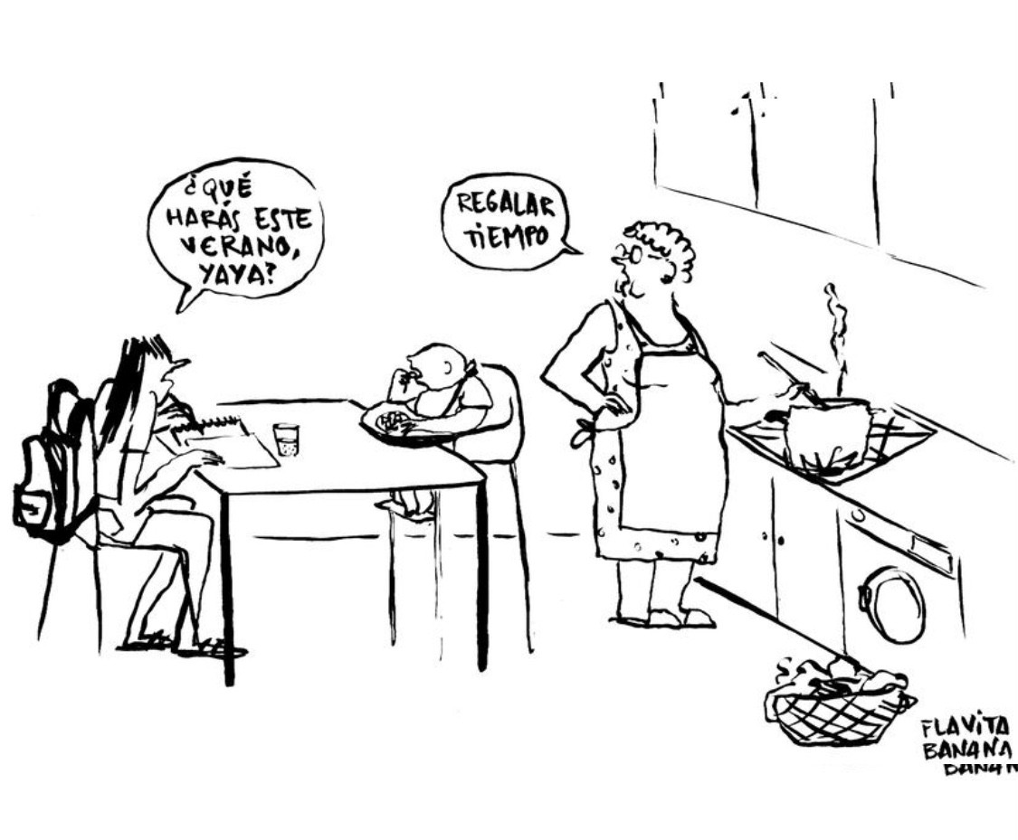
Grandma,
What will you do this summer?
Give the gift of time
Flavita Banana, Grandmothers in summer, El País, 27/06/2021

Slide 20
    The times of care: a kairos perspective (how)
Kairos time and the temporalities of care
Care is a fundamental human value (Engster, 2005). Caring means providing what is necessary to meet biological needs and support human development within the environment.
  We need one another from very early until very late in life, and this, far from being a flaw, is our strength (Martinón-Torres, 2022).
Caring means recognising human beings as vulnerable and dependent (Martín Palomo, 2016).
Caring has no precise temporal limits, nor a defined extension or magnitude. Cicero says of Kairos: “it has its own measure”.
It is processual time (Tronto), where “things take the time they need” (Davies, 1994).
Care work includes unpredictable tasks that are difficult to quantify by duration, such as listening, talking or playing, which require “slow time” (Wajcman, 2017).

Slide 21
    The times of care: a kairos perspective (how)
Kairos time and the temporalities of care
In addition to how much and when, the temporal dimension worth highlighting is how: Heidegger (1924) says that “time is the how”. It is kairos time: interaction and relation with others.
Human actions from the perspective of kairos challenge the clock and the calendar.
Care time escapes statistical operations (Time Use Surveys). The data from these surveys reflect only a small part of what caring means.
  Care may require 24-hour dedication (CIS, 2023). There is no precise beginning or end.
Care time viewed from kairos has different properties that bring us closer to its temporal qualities. Studying them requires asking: why (background and causes), for what purpose (objectives and aims), when (at what moment), where (chronotopia), and with whom (context and social relations).

Slide 22
    Kairos in infrastructures: park time
Why: it is a public space for community use. A priori, it is free from the time pressures of contracted work and committed domestic work, although this time is sometimes “contaminated” (porosity) by care responsibilities.
For what purpose: to leave the employment space or the domestic space; it is linked to free time. In the park, there is time to care, walk, exercise, enjoy and relax (well-being).
When: moments of the day and week linked to different activities and the participation of different groups: adult women (morning exercise); care and walks with older people and children; young people in various sports…
Where: an open space, close to home (desirable), with pedestrian access (importance of pavements in good condition), in contact with nature…
With whom: alone, accompanied, or with others depending on the activity.
Time lived in the park enables a relationship with the natural environment; it encourages care for the surroundings and helps construct and experience time from kairos: time for communication, with a sense of community.

Slide 23
    Notes for building the WIGI
The question is how to articulate care time:
Qualitative (it escapes measurement; it has its own measure)
Constructed in relation with others (through words and communication)
Kairological (moments, occasions, lived time)
Necessary for well-being
Within a quantitative index (WIGI),
Built from figures, requiring and providing numerical results
Suggestion:
Translating qualitative information into figures would reduce the richness of its content (why, for what purpose, when, with whom, and how).
Incorporate information from qualitative methodologies that precede or complement the WIGI, using data obtained through interviews, focus groups and participatory action-research workshops.

Slide 24
Thank you.
Thank you very much.

