Slide 1
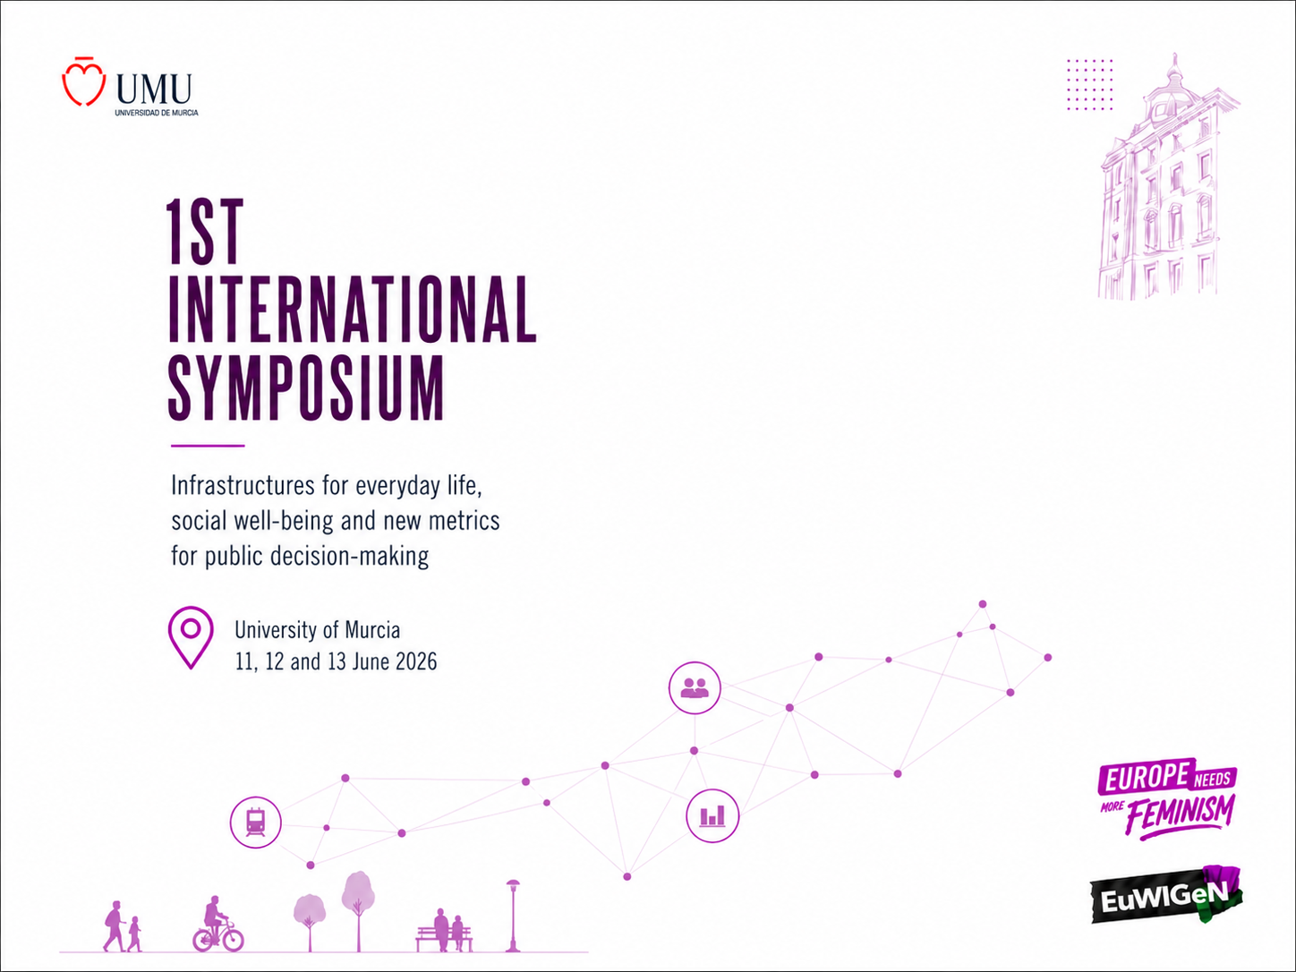
Promoting well being through a gender vision on infrastructures
Tindara Addabbo – Department of Economics Marco Biagi - University of Modena & Reggio Emilia - EuWIGeN
Notes:
Cover slide for the 1st International Symposium.

Slide 2



Promoting well being through a gender vision on infrastructures – Outline
The concept of Well-being and the theoretical approach
A gender vision on infrastructures and their impact on well-being
1st International Symposium “Infrastructures for Everyday Life, Social Well-being and New Metrics for Public Decision-Making”
Notes:
Standard content slide. Footer text is editable.

Slide 3
Promoting well being through a gender vision on infrastructures – Outline
The concept of Well-being and the theoretical approach
1st International Symposium “Infrastructures for Everyday Life, Social Well-being and New Metrics for Public Decision-Making”
Notes:
Standard content slide. Footer text is editable.

Slide 4
The concept of well-being in the capability approach
Well-being defined as a list of capabilities and functionings (doings and beings) according to Amartya Sen and Martha Nussbaum approach
1st International Symposium “Infrastructures for Everyday Life, Social Well-being and New Metrics for Public Decision-Making”
Notes:
Standard content slide. Footer text is editable.

Slide 5
The concept of well-being: A change of focus
Well-being in its multidimensional definition and in its complexity
1st International Symposium “Infrastructures for Everyday Life, Social Well-being and New Metrics for Public Decision-Making”
Notes:
Standard content slide. Footer text is editable.

Slide 6
Well-being in the capability approach: Defining the list of well-being dimensions
Martha Nussbaum’s Fundamental Capabilities list
Context-specific by following Robeyns’ criteria for the selection of capabilities
On the basis of the functions and sedimented values of the institutions involved in the analysis
By using a participatory definition of the list (this can increase community participation and awareness of gender differences and can lead the government to make commitments to a given list)
1st International Symposium “Infrastructures for Everyday Life, Social Well-being and New Metrics for Public Decision-Making”
Notes:
Standard content slide. Footer text is editable.

Slide 7
A list of capabilities
Access to knowledge
Living a healthy life
Working and carrying on business
Access to public resources (services and transfers)
Living and working in adequate and secure places and in an eco-compatible environment
Travel
Caring for others
Caring for oneself (time, culture, sport, recreation)
Participating in public life and living in an equitable society
1st International Symposium “Infrastructures for Everyday Life, Social Well-being and New Metrics for Public Decision-Making”
Notes:
Standard content slide. Footer text is editable.

Slide 8
How policies and infrastructures can impact on well-being
1st International Symposium “Infrastructures for Everyday Life, Social Well-being and New Metrics for Public Decision-Making”
Notes:
Standard content slide. Footer text is editable.

Slide 9
A focus on a set of capabilities
1st International Symposium “Infrastructures for Everyday Life, Social Well-being and New Metrics for Public Decision-Making”
Notes:
Standard content slide. Footer text is editable.

Slide 10
Living and working in adequate and secure places and in an eco-compatible environment
This capability regards the adequacy and security of all the private and public spaces in which human life goes on, whether in relation to working, personal or family life, to the acquisition of knowledge, or to travel between different places.
Housing, investments in the environment, transport infrastructures affect this capability
1st International Symposium “Infrastructures for Everyday Life, Social Well-being and New Metrics for Public Decision-Making”
Notes:
Standard content slide. Footer text is editable.

Slide 11
Living a healthy space
All the functions linked with the environment, road safety, and some social services, directly sustain this capability, which is also indirectly influenced by all the policies and infrastructures dealing with sport, school buildings, etc..
1st International Symposium “Infrastructures for Everyday Life, Social Well-being and New Metrics for Public Decision-Making”
Notes:
Standard content slide. Footer text is editable.

Slide 12
Travel
Individual’s ability to move it regards many infrastructures that can develop this capability or convert it into functionings through transport, roads and territorial planning. The same capability interacts with other important ones (like the ability to work, to be educated and trained, to care for oneself and others) by allowing and facilitating movements in daily life, with due care for their security and adequacy. In the interlinking of different capabilities one can see the different behaviours of women and men, their movements and motivations.
1st International Symposium “Infrastructures for Everyday Life, Social Well-being and New Metrics for Public Decision-Making”
Notes:
Standard content slide. Footer text is editable.

Slide 13
Caring for others
This capability includes the care work done both for one’s relatives residing in the nuclear family or outside it, and for others as unpaid voluntary work.
Social and physical infrastructures can impact on caring for others
1st International Symposium “Infrastructures for Everyday Life, Social Well-being and New Metrics for Public Decision-Making”
Notes:
Standard content slide. Footer text is editable.

Slide 14
Caring for oneself
Time, culture, sport and recreation. This capability includes both the possibility of having time for oneself, and the ability to use the time in recreational, cultural and sporting activities.
All the infrastructures and policies dealing with sport, free time, tourism and culture, can enable people to improve their lives. Indirectly they can give people more free time to spend on these activities through territorial planning, constructing roads and regulating road traffic to shorten both the time and length of journeys, and facilitating in different ways access to structures (sports halls, theatres, museums).
1st International Symposium “Infrastructures for Everyday Life, Social Well-being and New Metrics for Public Decision-Making”
Notes:
Standard content slide. Footer text is editable.

Slide 15
Caring for oneself
There is a clear nexus between this capability and others, such as living a healthy life (consider the positive impact that sport can have on this). Needless to say, cultural activities directly affect knowledge, and possibly impact on employment and business activity.
1st International Symposium “Infrastructures for Everyday Life, Social Well-being and New Metrics for Public Decision-Making”
Notes:
Standard content slide. Footer text is editable.

Slide 16
Promoting well being through a gender vision on infrastructures – Outline
A gender vision on infrastructures and their impact on well-being
1st International Symposium “Infrastructures for Everyday Life, Social Well-being and New Metrics for Public Decision-Making”
Notes:
Standard content slide. Footer text is editable.

Slide 17
Urban mobility infrastructures in a gender perspective
Public transport
Pavements and footpaths
Street lights
Parks
EIGE’ survey on the benefits of gender-sensitive infrastructures with the conceptual framework developed by Gloria Alarcón García & her research team
shows that women have a higher perception of the impact of those infrastructures in enabling different activities connected to the development of capabilities
1st International Symposium “Infrastructures for Everyday Life, Social Well-being and New Metrics for Public Decision-Making”
Notes:
Standard content slide. Footer text is editable.

Slide 18
Urban mobility infrastructures impact on capabilities in a gender perspective
Women are more likely to use public transport than men therefore public transport infrastructures matter in developing mobility and related capabilities
Women are more likely to be involved in transporting prams for children and wheelchairs for people with mobility impairments [pavements, quality of public transport…do matter in caring for others]
1st International Symposium “Infrastructures for Everyday Life, Social Well-being and New Metrics for Public Decision-Making”
Notes:
Standard content slide. Footer text is editable.

Slide 19
A list of capabilities
Access to knowledge
Living a healthy life
Working and carrying on business
Access to public resources (services and transfers)
Living and working in adequate and secure places and in an eco-compatible environment
Travel
Caring for others
Caring for oneself (time, culture, sport, recreation)
Participating in public life and living in an equitable society
1st International Symposium “Infrastructures for Everyday Life, Social Well-being and New Metrics for Public Decision-Making”
Notes:
Standard content slide. Footer text is editable.

Slide 20
Urban mobility infrastructures impact on capabilities in a gender intersectional perspective
Lower income women & men + older women are more likely to use public transports
Public transports availability, accessibility and affordability have a higher potential impact on developing capabilities and their conversion into functioning
European Parliament study on Social Inclusion in EU Public
Transport (2015)
1st International Symposium “Infrastructures for Everyday Life, Social Well-being and New Metrics for Public Decision-Making”
Notes:
Standard content slide. Footer text is editable.

Slide 21
Need of gender disaggregated infrastructures data
Improve the knowledge of different women and men needs in terms of infrastructures
Gender gaps in access to infrastructure
Different patterns of use and preferences between women and men,
Measurable benefits and risks that infrastructure poses to women and girls.
The case of Iceland in including gender-disaggregated data in its strategic planning of infrastructure and Canada Infrastructure Statistics Hub- Infrastructure Economic Account (INFEA)
1st International Symposium “Infrastructures for Everyday Life, Social Well-being and New Metrics for Public Decision-Making”
Notes:
Standard content slide. Footer text is editable.

Slide 22
Participatory approach in planning infrastructures
Include a gender vision on infrastructures in participatory planning
1st International Symposium “Infrastructures for Everyday Life, Social Well-being and New Metrics for Public Decision-Making”
Notes:
Standard content slide. Footer text is editable.

Slide 23

Promoting well being through a gender vision on infrastructures
Need of gender disaggregated data on the use and needs related to infrastructures
Include a gender vision on infrastructures in participatory planning and in the policies design
Special focus on infrastructures in gender budgeting and policies gender impact assessment with a focus on well-being

Slide 24

Thank for your attention!!!
Tindara Addabbo tindara.addabbo@unimore.it

